Slide 1
Circle Geometry
Chord Properties of the Circle

Slide 2
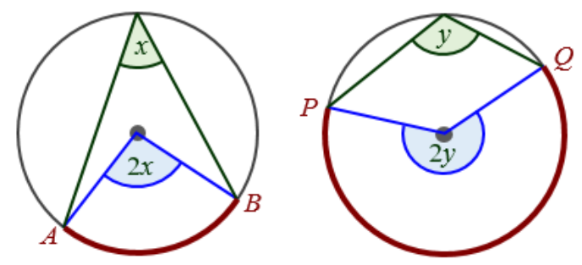
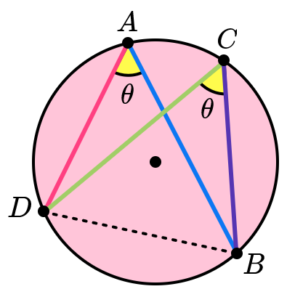
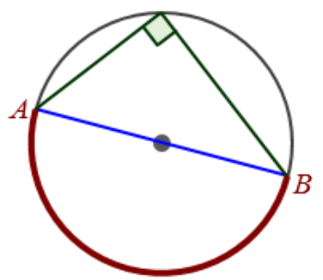
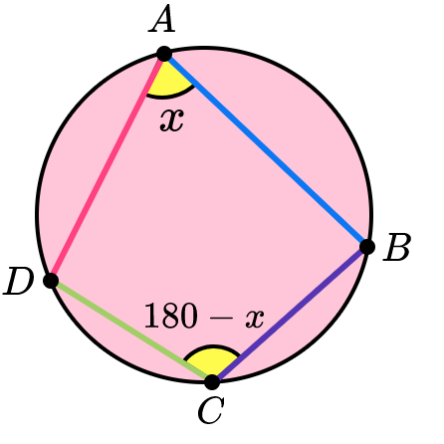


Theorem 1 – Angles in the centre
The angle at the centre of a circle is twice the angle at the circumference subtended by the same arc.
Theorem 2 – Angles in the same segment
Angles in the same segment of a circle are equal
Theorem 3 – Angle in a semicircle is a right angle
The angle subtended by a diameter at the circumference is equal to a right angle $(90°)$
Theorem 4 – Angles of a Cyclic Quadrilateral
Opposite angles of a cyclic quadrilateral are supplementary
(i.e. they add up to $180°$)

Slide 3
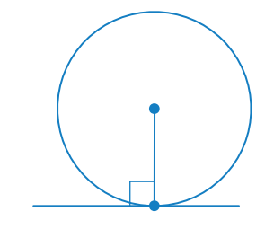
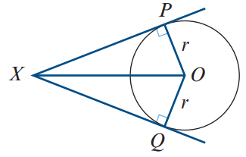
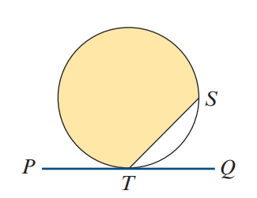
Theorem 5 – Tangent is perpendicular to the radius
A tangent to a circle is perpendicular to the radius drawn from the point of contact
Theorem 6 – Two tangents drawn the same point a point
Two tangents drawn from an external point to a circle are of equal length
Theorem 7 – Angle in Alternate segment
The angle between a tangent and a chord drawn from the point of contact is equal to any angle in the alternate segment.

Slide 4
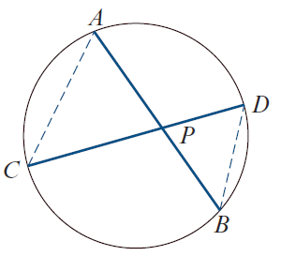
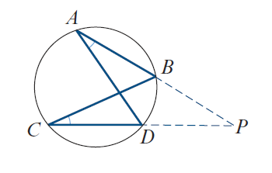
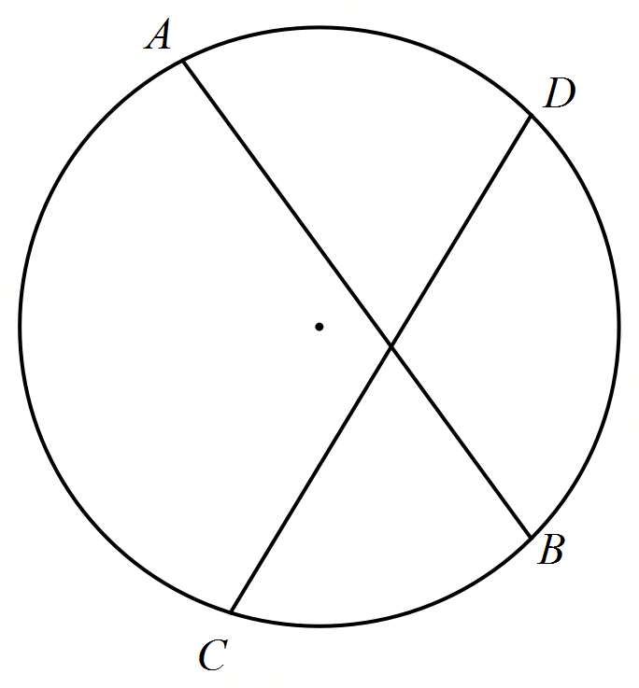
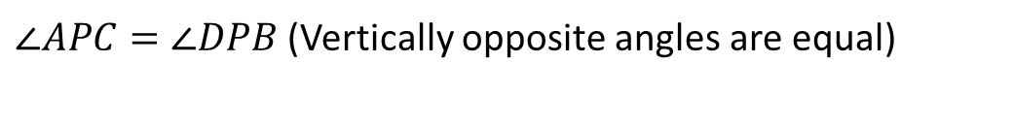
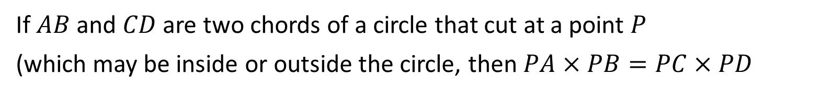

Theorem 8
If $AB$ and $CD$ are two chords of a circle that cut at a point $P$
(which may be inside or outside the circle, then $PA×PB=PC×PD$
Proof:
$∠APC=∠DPB$ (Vertically opposite angles are equal)
$∠CAP=∠BDP$ (Angles in the same segment are equal)
$∠ACP=∠DBP$ (Angles in the same segment are equal)
$$P$$
$∆ACP\sim ∆DBP$ (AAA)
$\frac{PA}{PC}=\frac{PD}{PB}$ (Corresponding sides in similar triangles have the same ratio)
$PA×PB=PC×PD$ (Proved)

Slide 5
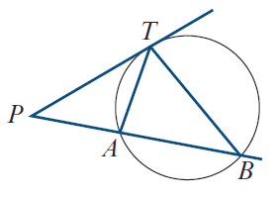

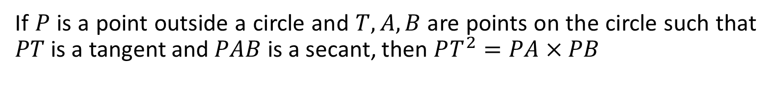




Theorem 9
If $P$ is a point outside a circle and $T, A, B$ are points on the circle such that $PT$ is a tangent and $PAB$ is a secant, then $PT^{2}=PA×PB$
Proof:
Let $∠TPB=α, ∠PBT=β$
$∠PBT=∠PTA=β$ (Angles in alternate segment are equal)
$$T$$
$∠TPB=∠APT=α$ (Common angle)
$∠PTB=∠PAT=180−α−β$ (Sum of angles in a triangle)
$$P$$
$∆PTB\sim ∆PAT$ (AAA)
$\frac{PT}{PB}=\frac{PA}{PT}$ (Corresponding sides in similar triangles have the same ratio)
$$A$$
$$B$$
$PT^{2}=PA×PB$ (Proved)

Slide 6
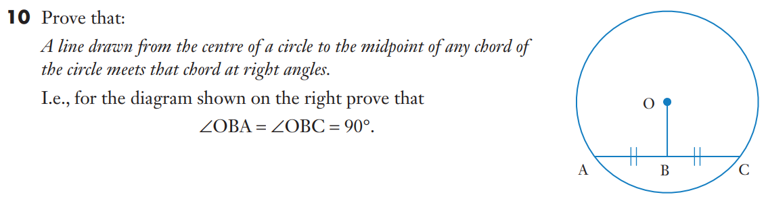








Extra- Theorem 10
$OA=OC$ (radius of circle)
$AB=CB$ (Given)
$OB$ is common line
$∆AOB≡$ $∆COB$ (SSS)
$∠OBA=∠OBC$ (Corresponding $∠$ in congruent triangles are equal)
$∠OBA+∠OBC=180°$(Supplementary angles)
$$2×∠OBC=180°$$
$∠OBC=90°$
$∠OBA=90°$ (proved)

Slide 7
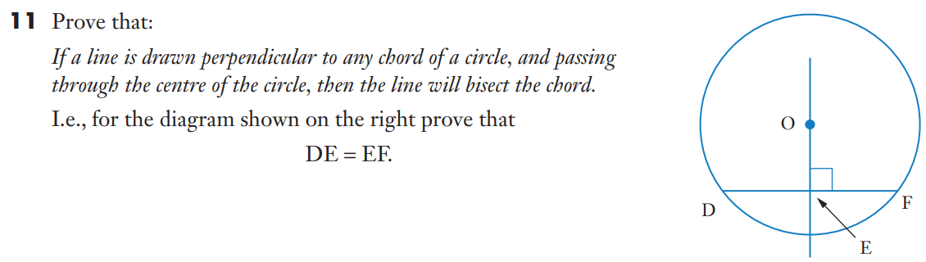




Extra- Theorem 11
$OD=OF$ (radius of circle)
$∠OED=∠OEF=90°$ (Supplementary angles)
$OB$ is common
$∆OED≡$ $∆OEF$ (RHS)
$∴DE=$ $FE$ (Corresponding sides in congruent triangles are equal)

Slide 8
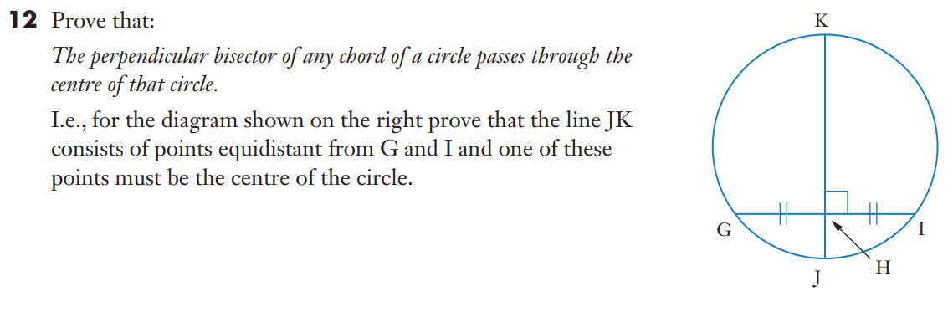





Extra- Theorem 12
$$P$$
$GH=IH$ (given)
$HP$ is common
$∠GHP=∠IHP=90°$ (Supplementary angles)
$∆GHP≡$ $∆IHP$ (SAS)
$PI=PG$ (Corresponding sides in congruent triangles are equal)
Since $PI=PG$, $PI$ and $PG$ must be the radius of the circle.
As such $P$, must be the centre of the circle.
Since $P$ lie on JK, $JK$ must pass through the centre of the circle.

Slide 9
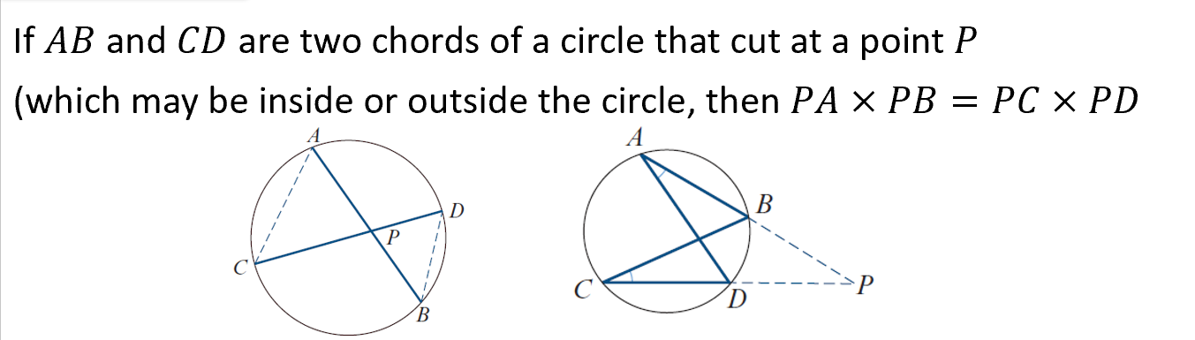













Cambridge Ex 8C Example 7
The arch of a bridge is to be in the form of an arc of a circle. The span of the bridge is to be
25 m and the height in the middle 2 m. Find the radius of the circle
$AP=BP=\frac{25}{2}=12.5$m
$$C$$
$CD$ is the diameter of the circle
Let $x$ be the radius of the circle
$2$
$$PD=2x−2$$
$$A$$
$$P$$
$$B$$
When two chords of a circle cut at a point, $PA×PB=PC×PD$
$$O$$
$$12.5(12.5)=2×(2x−2)$$
$$x=\frac{641}{16} m$$
$$D$$

Slide 10








Cambridge Ex 8C Example 8
Let A be any point inside a circle with radius r and centre O. Show that, if CD is a chord through A, then $CA ∙AD=r^{2}−OA^{2}$.
Let $PQ$ be the diameter of the circle that passes through A
When two chords of a circle cut at a point, $CA×AD=QA×AP$
$$C$$
Since $OQ$ is the radius of the circle, $OQ=r$
$$P$$
$$QA=r−OA$$
$$O$$
$$AP=r+OA$$
$Q$
$$A$$
$$CA×AD=\left(r−OA\right)\left(r+OA\right)$$
$CA×AD=r^{2}−OA^{2}$ (proved)
$$D$$

Slide 11








Cambridge Ex 8C Q3
Let $CD$ be the diameter of the circle that passes through P
$$CP=OC−PO=2 cm \\ DP=5+7=12 cm$$
Let $AP=x, BP=4x$
$$A$$
$$D$$
When two chords of a circle cut at a point, $AP×BP=CP×PD$
$$O$$
$$x\left(4x\right)=2(12)$$
$C$
$$P$$
$$4x^{2}=24$$
$$x^{2}=6$$
$$x=±\sqrt{6}$$
$$B$$
Length cannot be negative, $∴x=\sqrt{6}$
$$AB=5x=5\sqrt{6}$$

Slide 12
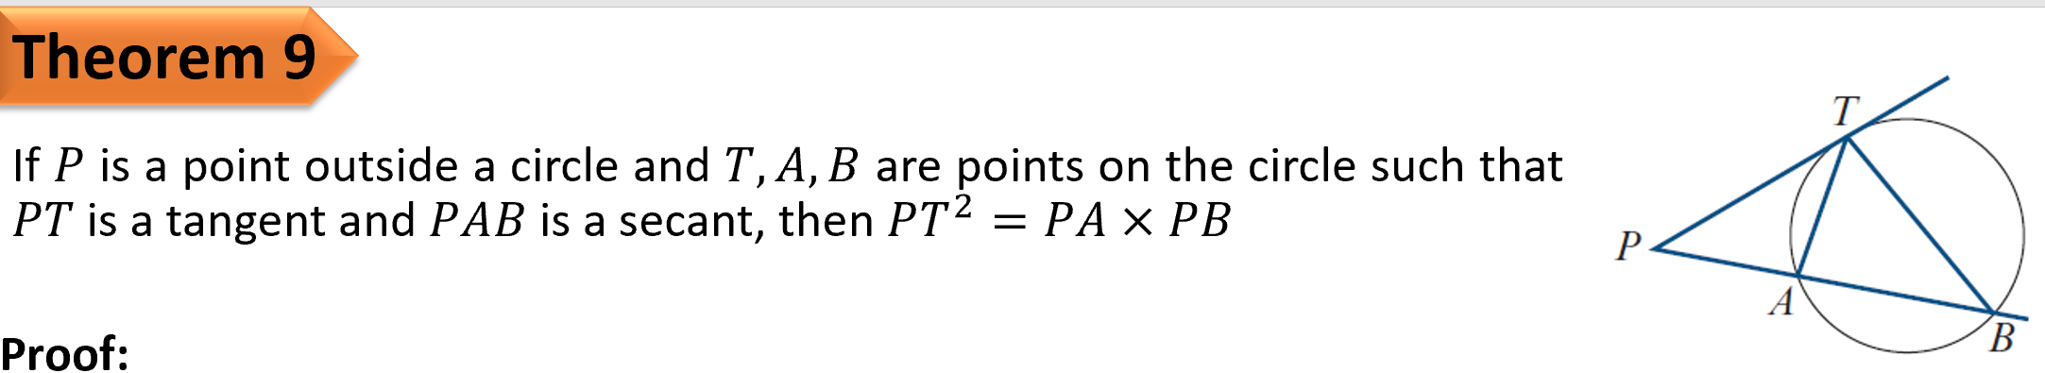









Cambridge Ex 8C Q3
$$PQ^{2}=PA×PB$$
$$P$$
$$PR^{2}=PA×PB$$
$$∴PQ^{2}=PR^{2}$$
$$PQ=PR$$
$$Q$$
$$A$$
$$R$$
$$B$$

Slide 13















Cambridge Ex 8C Q6
$$A$$
Let $P$ be a point on BC such that $AP⊥BC$
$$AB^{2}=BP^{2}+AP^{2}$$
$$AD^{2}=DP^{2}+AP^{2}$$
$$DP=BP−BD$$
$$AD^{2}={\left(BP−BD\right)}^{2}+AP^{2}$$
$$AD^{2}={BP}^{2}−2\left(BP\right)\left(BD\right)+BD^{2}+AP^{2}$$
$$AD^{2}={BP}^{2}+AP^{2}−BD(2BP−BD)$$
$$AD^{2}=AB^{2}−BD(DC)$$
$$D$$
$$B$$
$$P$$
$$C$$
$$BD\left(DC\right)=AD(DE)$$
$$AD^{2}=AB^{2}−AD(DE)$$
$$E$$
$$AB^{2}=AD^{2}+AD(DE)$$
$$AB^{2}=AD(AD+DE)$$
$AB^{2}=AD(AE)$ (proved)

Slide 14
Cambridge Ex 8C
Independent Practice

