Slide 1
Conjecture and Proof
Proof by Mathematical Induction

Slide 2









Mathematical Induction
Consider the sum of the first $n$ odd numbers
$=1^{2}$
$1=1$
$1+3=4$
$=2^{2}$
$=3^{2}$
$1+3+5=9$
$1+3+5+7=16$
$=4^{2}$
Generalising this, we have
$P\left(n\right)=1+3+5+7+…+(2n−1)$
$=n^{2}$
How can we prove this is true for all cases?

Slide 3




Mathematical Induction - Structure
Let $P\left(n\right)$ be the proposition
Step 1: Consider $n=1$
Prove that $P(1)$ is true
Step 2: Assume $P(k)$ is true for $n=k, k∈ℕ$
State $P(k)$
Step 3: Consider $n=k+1, k∈ℕ$ , State $P(k+1)$
Prove that $P(k+1)$ is true using $P(k)$
Step 4: Conclusion
We have proved that since $P(1)$ is true and $P(k+1)$ is true if $P(k)$ is true for $k∈ℕ$
Hence, by the principle of mathematical induction, $P(n)$ is true for all positive integers of $n$

Slide 4
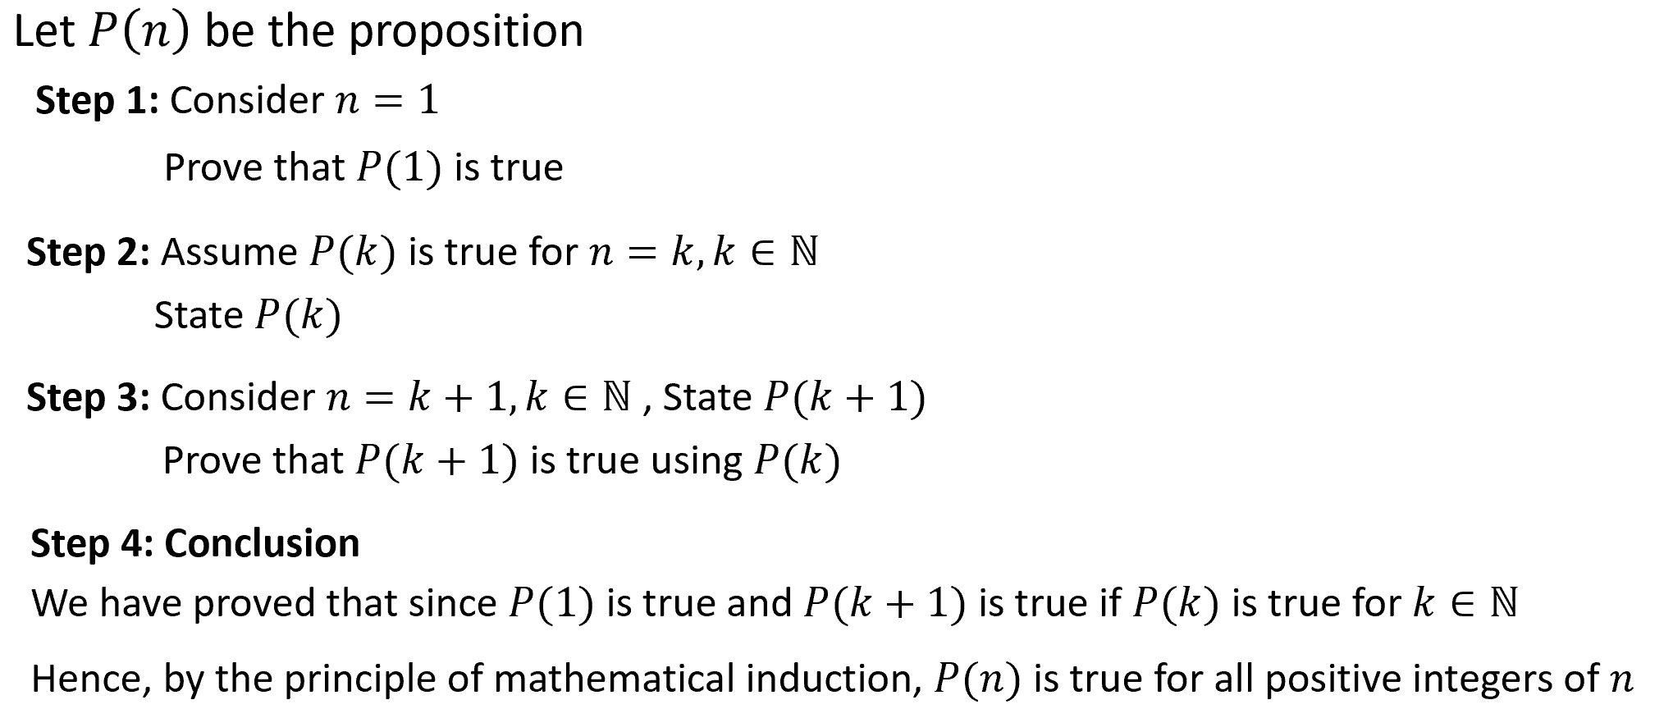









Guided Practice
Prove that $1+3+5+7+…+\left(2n−1\right)=n^{2}, ∀n∈ℕ$
Let $P(n)$ be the proposition where
$$P\left(n\right)=1+3+5+7+…+\left(2n−1\right)=n^{2}$$
Consider $n=1$
LHS $=1$
$$=1^{2}=RHS (proved)$$
$∴P(1)$ is true
Assume $P(k)$ is true for $n=k, where k∈ℕ$
$$P\left(k\right)=1+3+5+7+…+\left(2k−1\right)=k^{2}$$
Consider $n=k+1$
Prove: $P\left(k+1\right)=1+3+5+7+…+\left(2(k+1)−1\right)={\left(k+1\right)}^{2}$ is true
LHS $=1+3+5+7+…+\left(2k−1\right)+\left(2\left(k+1\right)−1\right)$
$$=k^{2}+2k+2−1$$
(Using $P(k)$ since it is true)
$$=k^{2}+2k+1$$
$={\left(k+1\right)}^{2}=RHS$(proved)
We have proved that since $P(1)$ is true and $P(k+1)$ is true if $P(k)$ is true for $k∈ℕ$
Hence, by the principle of mathematical induction, $P(n)$ is true for all positive integers of $n$

Slide 5

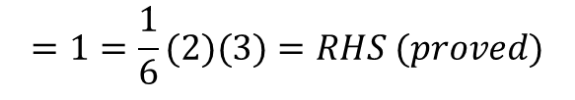



Guided Practice
Prove that $1^{2}+2^{2}+3^{2}+…+n^{2}=\frac{n}{6}(n+1)(2n+1), ∀n∈ℕ$
Let $P(n)$ be the proposition where
$$P\left(n\right)=1^{2}+2^{2}+3^{2}+…+n^{2}=\frac{n}{6}(n+1)(2n+1)$$
Consider $n=1$
LHS $=1^{2}$
$$=1=\frac{1}{6}(2)(3)=RHS (proved)$$
$∴P(1)$ is true
Assume $P(k)$ is true for $n=k, where k∈ℕ$
$$P\left(k\right)=1^{2}+2^{2}+3^{2}+…+k^{2}=\frac{k}{6}(k+1)(2k+1)$$
Consider $n=k+1$
Prove: $P\left(k+1\right)=1^{2}+2^{2}+3^{2}+…+k^{2}+{\left(k+1\right)}^{2}=\frac{k+1}{6}(k+2)(2k+3)$ is true

Slide 6







Guided Practice
Prove that $1^{2}+2^{3}+3^{2}+…+n^{2}=\frac{n}{6}(n+1)(2n+1), ∀n∈ℕ$
Prove: $P\left(k+1\right)=1^{2}+2^{2}+3^{2}+…+k^{2}+{\left(k+1\right)}^{2}=\frac{k+1}{6}(k+2)(2k+3)$ is true
LHS= $P\left(k+1\right)=1^{2}+2^{2}+3^{2}+…+k^{2}+{\left(k+1\right)}^{2}$
$$=\frac{k}{6}\left(k+1\right)\left(2k+1\right)+{\left(k+1\right)}^{2}$$
(Using $P(k)$ since it is true)
$$=\frac{k+1}{6}[k\left(2k+1\right)+6\left(k+1\right)]$$
$$=\frac{k+1}{6}[2k^{2}+k+6k+6]$$
$$=\frac{k+1}{6}[2k^{2}+7k+6]$$
$$=\frac{k+1}{6}(k+2)(2k+3)$$
$=RHS$(proved)
We have proved that since $P(1)$ is true and $P(k+1)$ is true if $P(k)$ is true for $k∈ℕ$
Hence, by the principle of mathematical induction, $P(n)$ is true for all positive integers of $n$

Slide 7


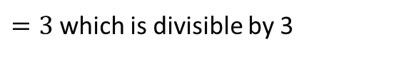





Guided Practice
Prove by induction that $7^{n}−4 is divisible by 3 ∀n∈ℕ$
Let $P(n)$ be the proposition where
$P\left(n\right)=7^{n}−4$ is divisible by 3
Consider $n=1$
LHS $=7^{1}−4$
$=3$ which is divisible by 3
$∴P(1)$ is true
Assume $P(k)$ is true for $n=k, where k∈ℕ$
$$P\left(k\right)=7^{k}−4=3m, where m∈ℤ$$
Consider $n=k+1$
Prove: $P\left(k+1\right)=7^{k+1}−4$ is divisible by 3
LHS= $P\left(k+1\right)=7^{k+1}−4$
$$=7^{k}×7−4$$
$$=7(3m+4)−4$$
(Using $P(k)$ since it is true)
$$=21m+28−4$$
$$=21m+24$$
$$=3\left(7m+8\right)$$
We have proved that since $P(1)$ is true and $P(k+1)$ is true if $P(k)$ is true for $k∈ℕ$
$∴P(k+1)$ is divisible by 3
Hence, by the principle of mathematical induction, $P(n)$ is true for all positive integers of $n$

Slide 8


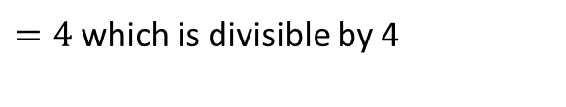




Guided Practice
Prove by induction that $7^{n}−3^{n} is divisible by 4 , ∀n∈ℕ$
Let $P(n)$ be the proposition where
$P\left(n\right)=7^{n}−3^{n}$ is divisible by 4
Consider $n=1$
LHS $=7^{1}−3^{1}$
$=4$ which is divisible by 4
$∴P(1)$ is true
Assume $P(k)$ is true for $n=k, where k∈ℕ$
$$P\left(k\right)=7^{k}−3^{k}=4m, where m∈ℤ$$
Consider $n=k+1$
Prove: $P\left(k+1\right)=7^{k+1}−3^{k+1}$is divisible by 4
LHS= $P\left(k+1\right)=7^{k+1}−3^{k+1}$
$$=7^{k}×7−3×3^{k}$$
$$=7\left(4m+3^{k}\right)−3×3^{k}$$
(Using $P(k)$ since it is true)
$$=28m+7×3^{k}−3×3^{k}$$
$$=28m+4×3^{k}$$
$$=4\left(7m+3^{k}\right)$$
We have proved that since $P(1)$ is true and $P(k+1)$ is true if $P(k)$ is true for $k∈ℕ$
$∴P(k+1)$ is divisible by 4
Hence, by the principle of mathematical induction, $P(n)$ is true for all positive integers of $n$

Slide 9



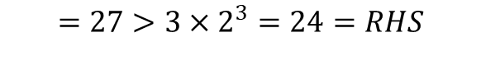







Guided Practice
Prove by induction that $3^{n}>3×2^{n} where ∀n∈ℕ and n≥3$
Let $P(n)$ be the proposition where
$$P\left(n\right)=3^{n}>3×2^{n}$$
Consider $n=3$
LHS $=3^{3}$
$$=27>3×2^{3}=24=RHS$$
$∴P(3)$ is true
Assume $P(k)$ is true for $n=k, where k∈ℕ , k≥3$
$$P\left(k\right)=3^{k}>3×2^{k}$$
Consider $n=k+1$
Prove: $P\left(k+1\right)=3^{k+1}>3×2^{k+1}$
LHS= $P\left(k+1\right)=3^{k+1}$
$$=3∙3^{k}$$
$$>3×3×2^{k}$$
(Using $P(k)$ since it is true)
$$>3×2×2^{k}$$
(Since $3>2$)
$$=3×2^{k+1}$$
$$=RHS$$
We have proved that since $P(3)$ is true and $P(k+1)$ is true if $P(k)$ is true for $k∈ℕ$
Hence, by the principle of mathematical induction, $P(n)$ is true for $∀n∈ℕ and n≥3$

Slide 10









Guided Practice
Prove by induction that $n!>2^{n} where ∀n∈ℕ and n≥4$
Let $P(n)$ be the proposition where
$$P\left(n\right)=n!>2^{n}$$
Consider $n=4$
LHS $=4!$
$$=24>2^{4}=16=RHS$$
$∴P(4)$ is true
Assume $P(k)$ is true for $n=k, where k∈ℕ, k≥4$
$$P\left(k\right)=k!>2^{k}$$
Consider $n=k+1$
Prove: $P\left(k+1\right)=(k+1)!>2^{k+1}$
LHS= $P\left(k+1\right)=(k+1)!$
$$=k!(k+1)$$
$$>2^{k}(k+1)$$
(Using $P(k)$ since it is true)
$$>2×2^{k}$$
(Since $k+1>2$)
$$=2^{k+1}$$
$$=RHS$$
We have proved that since $P(3)$ is true and $P(k+1)$ is true if $P(k)$ is true for $k∈ℕ$
Hence, by the principle of mathematical induction, $P(n)$ is true for $∀n∈ℕ and n≥4$

Slide 11


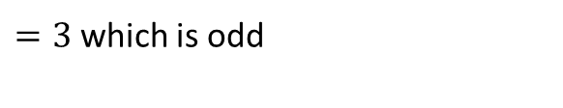




Guided Practice
Prove by induction that $3^{n} is odd , ∀n∈ℕ$
Let $P(n)$ be the proposition where
$P\left(n\right)=3^{n}$ is odd
Consider $n=1$
LHS $=3^{1}$
$=3$ which is odd
$∴P(1)$ is true
Assume $P(k)$ is true for $n=k, where k∈ℕ,$
$$P\left(k\right)=3^{k}=2m+1, where m∈ℤ$$
Consider $n=k+1$
Prove: $P\left(k+1\right)=3^{k+1}$ is odd
LHS= $P\left(k+1\right)=3^{k+1}$
$$=3×3^{k}$$
$$=3(2m+1)$$
(Using $P(k)$ since it is true)
$$=6m+3$$
$$=2\left(3m+1\right)+1$$
which is odd
$∴P(k+1)$ is odd
We have proved that since $P(1)$ is true and $P(k+1)$ is true if $P(k)$ is true for $k∈ℕ$
Hence, by the principle of mathematical induction, $P(n)$ is true for all positive integers of $n$

Slide 12








Guided Practice
Given that ${t_{1}=11, t_{n+1}=10t_{n}−9}^{ }$prove that $t_{n}=10^{n}+1$
Let $P(n)$ be the proposition where
$$t_{n}={10}^{n}+1$$
Consider $n=1$
Given $t_{1}=11$
$$t_{1}={10}^{1}+1=11$$
$∴P(1)$ is true
Assume $P(k)$ is true for $n=k, where k∈ℕ,$
$$t_{k}={10}^{k}+1$$
Consider $n=k+1$
Prove: $P\left(k+1\right) where t_{k+1}={10}^{k+1}+1$is true
LHS of $P\left(k+1\right)=t_{k+1}$
$$=10t_{k}−9$$
$$=10\left({10}^{k}+1\right)−9$$
(Using $P(k)$ since it is true)
$$={10}^{k+1}+10−9$$
$$={10}^{k+1}+1$$
$$=RHS(proved)$$
$∴P(k+1)$ is true
We have proved that since $P(1)$ is true and $P(k+1)$ is true if $P(k)$ is true for $k∈ℕ$
Hence, by the principle of mathematical induction, $P(n)$ is true for all positive integers of $n$

Slide 13







Guided Practice
Given that ${a_{1}=3, a_{n+1}=2a_{n}−n+1}^{ }$prove that $a_{n}=2^{n}+n$
Let $P(n)$ be the proposition where
$$a_{n}=2^{n}+n$$
Consider $n=1$
Given $a_{1}=3$
$$a_{1}=2^{1}+1=3$$
$∴P(1)$ is true
Assume $P(k)$ is true for $n=k, where k∈ℕ,$
$$a_{k}=2^{k}+k$$
Consider $n=k+1$
Prove: $P\left(k+1\right) where{ a}_{k+1}=2^{k+1}+k+1$is true
LHS of $P\left(k+1\right)={ a}_{k+1}$
$$=2a_{k}−k+1$$
$$=2(2^{k}+k)−k+1$$
(Using $P(k)$ since it is true)
$$={2∙2}^{k}+2k−k+1$$
$$=2^{k+1}+k+1$$
$$=RHS(proved)$$
$∴P(k+1)$ is true
We have proved that since $P(1)$ is true and $P(k+1)$ is true if $P(k)$ is true for $k∈ℕ$
Hence, by the principle of mathematical induction, $P(n)$ is true for all positive integers of $n$

Slide 14
Independent Practice
Cambridge Ex 6F

