Slide 1
Trigonometrical Identities
Pythagorean Identities

Slide 2
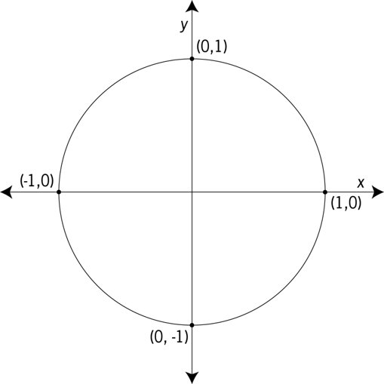




The Pythagorean Identity
By Pythagoras theorem,
$$OP^{2}=OM^{2}+MP^{2}$$
P
$$1={\left(\cos\left(θ\right)\right)}^{2}+{\left(\sin\left(θ\right)\right)}^{2}$$
1
$$θ$$
$$\sin{(θ)}$$
$$∴\sin^{2}{(θ)}+\cos^{2}{(θ})=1$$
O
$$\cos{(θ)}$$
M

Slide 3


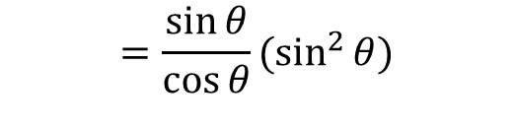
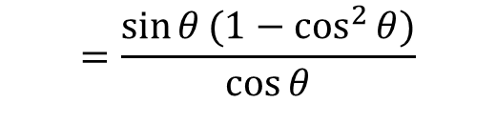
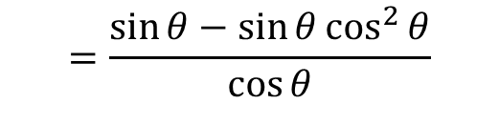


Proving Other identities
Prove: $\tan{θ}−\sin{θ}\cos{θ}=\sin^{2}{θ}\tan{θ}$
Proof:
LHS= $\tan{θ}−\sin{θ}\cos{θ}$
$$=\frac{\sin{θ}}{\cos{θ}}−\sin{θ}\cos{θ}$$
$$=\frac{\sin{θ}−\sin{θ}\cos^{2}{θ}}{\cos{θ}}$$
$$=\frac{\sin{θ}(1−\cos^{2}{θ})}{\cos{θ}}$$
$$=\frac{\sin{θ}}{\cos{θ}}(\sin^{2}{θ})$$
$$=\tan{θ}\sin^{2}{θ}$$
$=RHS$ (Proved)
Note: Better to start on the side that is more “complicated” and attempt to simplify it.

Slide 4





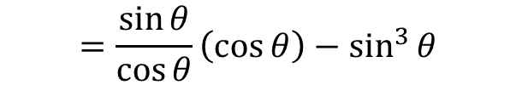
Proving Other identities
Prove: $\tan{θ}\cos{θ}−\sin^{3}{θ}=\sin{θ}\cos^{2}{θ}$
Proof:
LHS= $\tan{θ}\cos{θ}−\sin^{3}{θ}$
$$=\frac{\sin{θ}}{\cos{θ}}\left(\cos{θ}\right)−\sin^{3}{θ}$$
$$=\sin{θ}−\sin^{3}{θ}$$
$$=\sin{θ}(1−\sin^{2}{θ})$$
$$=\sin{θ}\cos^{2}{θ}$$
$=RHS$ (Proved)

Slide 5





Sadler Ex 9A Q1
Prove: $2\cos^{2}{θ}+3=5−2\sin^{2}{θ}$
Proof:
LHS =$2\cos^{2}{θ}+3$
$$=2\left(1−\sin^{2}{θ}\right)+3$$
$$=2−2\sin^{2}{θ}+3$$
$$=5−2\sin^{2}{θ}$$
$=RHS$ (Proved)

Slide 6



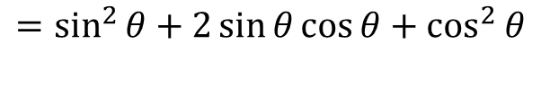
Sadler Ex 9A Q3
Prove: ${\left(sin θ+\cos{θ}\right)}^{2}=2\sin{θ}\cos{θ}+1$
Proof:
LHS = ${\left(sin θ+\cos{θ}\right)}^{2}$
$$=\sin^{2}{θ}+2\sin{θ}\cos{θ}+\cos^{2}{θ}$$
$$=1+2\sin{θ}\cos{θ}$$
$=RHS$ (Proved)

Slide 7






Sadler Ex 9A Q5
Prove: $\sin^{4}{θ}−\cos^{4}{θ}=1−2\cos^{2}{θ}$
Proof:
LHS = $\sin^{4}{θ}−\cos^{4}{θ}$
$$=(\sin^{2}{θ}−\cos^{2}{θ})(\sin^{2}{θ}+\cos^{2}{θ})$$
$$=(\sin^{2}{θ}−\cos^{2}{θ})(1)$$
$$=1−\cos^{2}{θ}−\cos^{2}{θ}$$
$$=1−2\cos^{2}{θ}$$
$=RHS$ (Proved)

Slide 8


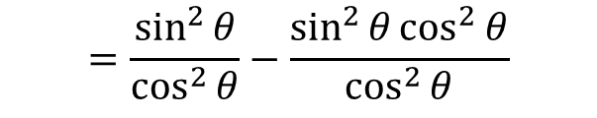
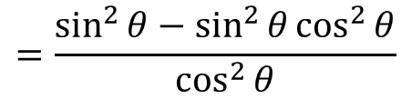
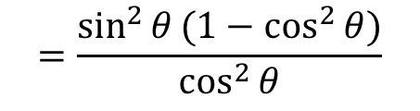
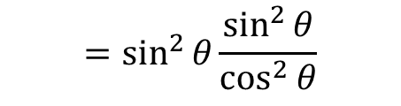

Sadler Ex 9A Q7
Prove: $\sin^{2}{θ}\tan^{2}{θ}=\tan^{2}{θ}−\sin^{2}{θ}$
Proof:
LHS = $\sin^{2}{θ}\tan^{2}{θ}$
$$=\sin^{2}{θ}\frac{\sin^{2}{θ}}{\cos^{2}{θ}}$$
$$=\frac{\sin^{2}{θ}(1−\cos^{2}{θ})}{\cos^{2}{θ}}$$
$$=\frac{\sin^{2}{θ}−\sin^{2}{θ}\cos^{2}{θ}}{\cos^{2}{θ}}$$
$$=\frac{\sin^{2}{θ}}{\cos^{2}{θ}}−\frac{\sin^{2}{θ}\cos^{2}{θ}}{\cos^{2}{θ}}$$
$$=\tan^{2}{θ}−\sin^{2}{θ}$$
$=RHS$ (Proved)

Slide 9







Sadler Ex 9A Q10
Prove: $\frac{1}{1+\tan^{2}{θ}}=\cos^{2}{θ}$
Proof:
LHS = $\frac{1}{1+\tan^{2}{θ}}$
$$=\frac{1}{1+\frac{\sin^{2}{θ}}{\cos^{2}{θ}}}$$
$$=\frac{1}{\frac{\cos^{2}{θ}+\sin^{2}{θ}}{\cos^{2}{θ}}}$$
$$=\frac{\cos^{2}{θ}}{\cos^{2}{θ}+\sin^{2}{θ}}$$
$$=\frac{\cos^{2}{θ}}{1}$$
$$=\cos^{2}{θ}$$
$=RHS$ (Proved)

Slide 10




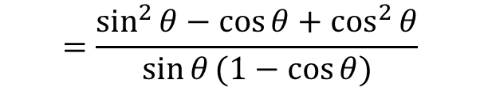
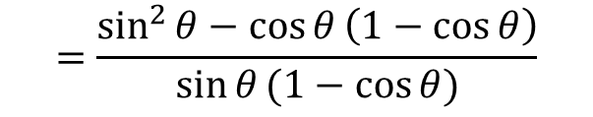
Sadler Ex 9A Q12
Prove: $\frac{\sin{θ}}{1−\cos{θ}}−\frac{\cos{θ}}{\sin{θ}}=\frac{1}{\sin{θ}}$
Proof:
LHS = $\frac{\sin{θ}}{1−\cos{θ}}−\frac{\cos{θ}}{\sin{θ}}$
$$=\frac{\sin^{2}{θ}−\cos{θ}\left(1−\cos{θ}\right)}{\sin{θ}(1−\cos{θ})}$$
$$=\frac{\sin^{2}{θ}−\cos{θ}+\cos^{2}{θ}}{\sin{θ}(1−\cos{θ})}$$
$$=\frac{1−\cos{θ}}{\sin{θ}(1−\cos{θ})}$$
$$=\frac{1}{\sin{θ}}$$
$=RHS$ (Proved)

Slide 11
Sadler Ex 9A
Independent Practice

