Slide 1
Trigonometrical Identities
Trigonometric Reciprocals

Slide 2













Concept Development
Reciprocals of sin, cos and tan
$$\frac{1}{\sin{θ}}$$
Reciprocal of $\sin{θ=}$
$$=cosec θ$$
$$(cosecant)$$
$$\frac{1}{\cos{θ}}$$
$$=sec θ$$
Reciprocal of $\cos{θ=}$
$$(secant)$$
$$\frac{\cos{(θ)}}{\sin{(θ)}}$$
Reciprocal of $\tan{θ=}$
$$=cot θ$$
$$(cotangent)$$
$$Note : \cot\left(\frac{π}{2}\right)=\frac{cos\left(\frac{π}{2}\right)}{\sin\left(\frac{π}{2}\right)}=\frac{0}{1}=0$$

Slide 3

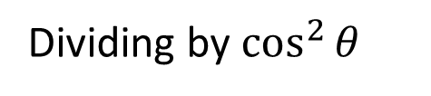
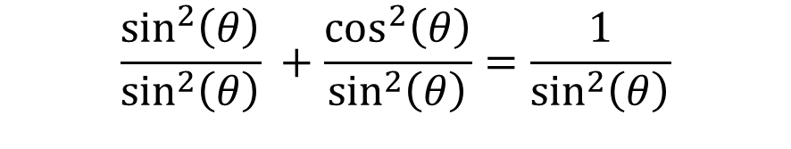

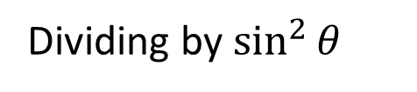

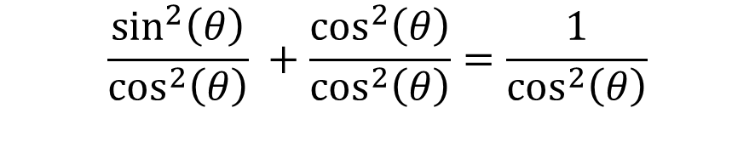
Pythagorean Identity of reciprocal functions
Recall,
$\sin^{2}{(θ)}+\cos^{2}{(θ})=1$
Dividing by $\cos^{2}{θ}$
Dividing by $\sin^{2}{θ}$
$$\frac{\sin^{2}\left(θ\right)}{\cos^{2}\left(θ\right)} +\frac{\cos^{2}\left(θ\right)}{\cos^{2}\left(θ\right)}=\frac{1}{\cos^{2}\left(θ\right)}$$
$$\frac{\sin^{2}\left(θ\right)}{\sin^{2}\left(θ\right)} +\frac{\cos^{2}\left(θ\right)}{\sin^{2}\left(θ\right)}=\frac{1}{\sin^{2}\left(θ\right)}$$
$$\tan^{2}{(θ)} +1=\sec^{2}{(θ)}$$
$$1 +\cot^{2}{(θ)}={cosec}^{2}{(θ)}$$

Slide 4

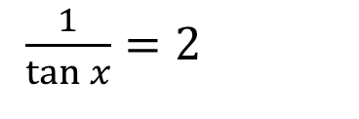

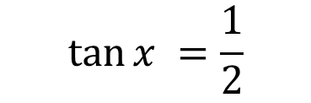
Guided Practice
Solve $\cot{x}=2, −π≤x≤π$
$\frac{1}{\tan{x}}=2$
$$\tan{x} =\frac{1}{2}$$
$$x=−2.68, 0.46$$

Slide 5
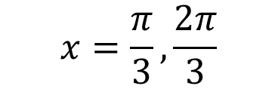
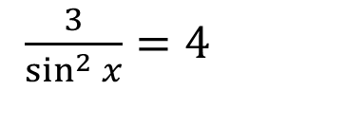
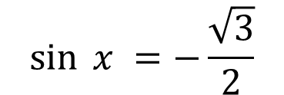
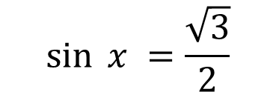
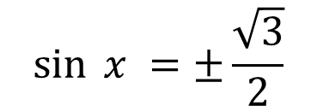
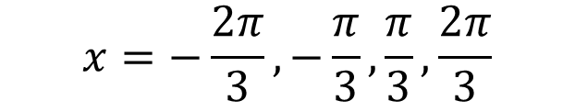
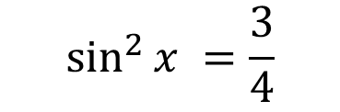
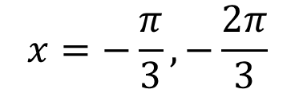
Sadler Ex 9E Q2
Solve $3{cosec}^{2}{x}=4, −π≤x≤π$
$\frac{3}{\sin^{2}{x}}=4$
$$\sin^{2}{x} =\frac{3}{4}$$
$$\sin^{ }{x} =±\frac{\sqrt{3}}{2}$$
$$\sin^{ }{x} =\frac{\sqrt{3}}{2}$$
$$\sin^{ }{x} =−\frac{\sqrt{3}}{2}$$
$$x=\frac{π}{3},\frac{2π}{3}$$
$$x=−\frac{π}{3},−\frac{2π}{3}$$
$$x=−\frac{2π}{3},−\frac{π}{3},\frac{π}{3},\frac{2π}{3}$$

Slide 6








Sadler Ex 9E Q3
Solve $\sin{x}\sec{x}−3\sin{x}=0, 0≤x≤360°$
$\sin{x}\left(\sec{x}−3\right)=0$
$\sin{x}=0, \left(\sec{x}−3\right)=0$
$x=0, 180°, 360°$
$$\sec{x}=3$$
$$\frac{1}{\cos{x}}=3$$
$$\cos{x}=\frac{1}{3}$$
$$x=70.53°, 289.47°$$
$$x=0, 70.53°, 180°, 289.47°, 360°$$

Slide 7





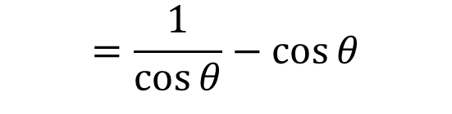
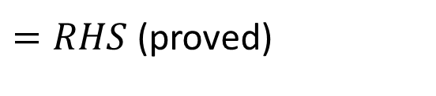
Guided Practice
Prove: $\sec{θ}−\cos{θ}=\sin{θ}\tan{θ}$
$$LHS=\sec{θ−\cos{θ}}$$
$$=\frac{1}{\cos{θ}}−\cos{θ}$$
$$=\frac{1−\cos^{2}{θ}}{\cos{θ}}$$
$$=\frac{\sin^{2}{θ}}{\cos{θ}}$$
$$=\sin{θ}×\frac{\sin{θ}}{\cos{θ}}$$
$$=\sin{θ}\tan{θ}$$
$=RHS$ (proved)

Slide 8

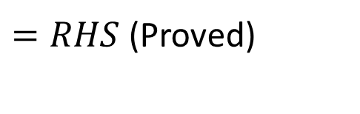


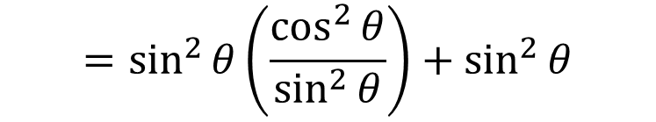
Sadler Ex 9E Q9
Prove: $1=\sin^{2}{θ}\cot^{2}{θ}+\sin^{2}{θ}$
$$RHS=\sin^{2}{θ}\cot^{2}{θ}+\sin^{2}{θ}$$
$$=\sin^{2}{θ}\left(\frac{\cos^{2}{θ}}{\sin^{2}{θ}}\right)+\sin^{2}{θ}$$
$$=\cos^{2}{θ}+\sin^{2}{θ}$$
$$=1$$
$=RHS$(Proved)

Slide 9
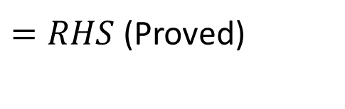


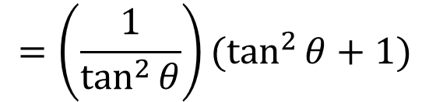


Sadler Ex 9E Q11
Prove: $1+\cot^{2}{θ}=\cot^{2}{θ}\sec^{2}{θ}$
$$LHS=1+\cot^{2}{θ}$$
$$=1+\frac{1}{\tan^{2}{θ}}$$
$$=\frac{\tan^{2}{θ}+1}{\tan^{2}{θ}}$$
$$=\left(\frac{1}{\tan^{2}{θ}}\right)(\tan^{2}{θ}+1)$$
$$=\cot^{2}{θ}\sec^{2}{θ}$$
$=RHS$(Proved)

Slide 10



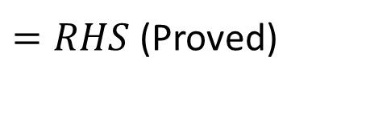


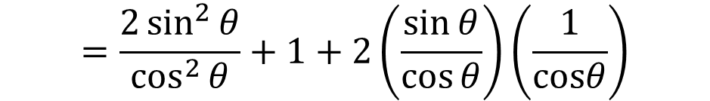

Sadler Ex 9E Q14
Prove: $\frac{1+\sin{θ}}{1−\sin{θ}}=2\tan^{2}{θ}+1+2\tan{θ}\sec{θ}$
$$RHS=2\tan^{2}{θ}+1+2\tan{θ}\sec{θ}$$
$$=\frac{2\sin^{2}{θ}}{\cos^{2}{θ}}+1+2\left(\frac{\sin{θ}}{\cos{θ}}\right)\left(\frac{1}{cosθ}\right)$$
$$=\frac{2\sin^{2}{θ}}{\cos^{2}{θ}}+\frac{\cos^{2}{θ}}{\cos^{2}{θ}}+\frac{2\sin{θ}}{\cos^{2}{θ}}$$
$$=\frac{{\left(1+\sin{θ}\right)}^{2}}{(1−\sin{θ})(1+\sin{θ})}$$
$$=\frac{2\sin^{2}{θ}+\cos^{2}{θ}+2\sin{θ}}{\cos^{2}{θ}}$$
$$=\frac{1+\sin{θ}}{1−\sin{θ}}$$
$$=\frac{2\sin^{2}{θ}+1−\sin^{2}{θ}+2\sin{θ}}{\cos^{2}{θ}}$$
$=RHS$(Proved)
$$=\frac{\sin^{2}{θ}+2\sin{θ}+1}{1−\sin^{2}{θ}}$$

Slide 11
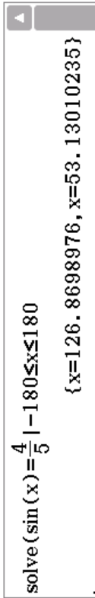

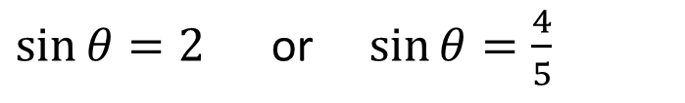
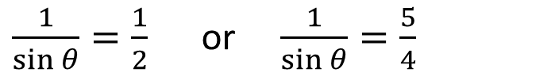



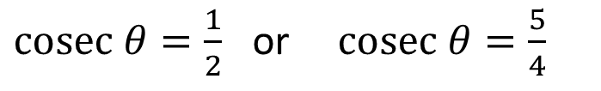



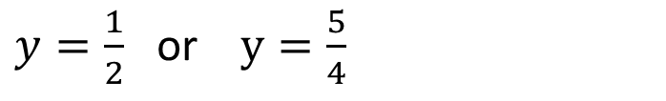
Guided Practice
Solve $8\cot^{2}θ=14\operatorname{cosec}{θ}−13, −180°≤x≤180°$
$$8\cot^{2}θ=14\operatorname{cosec}{θ}−13$$
$$1 +\cot^{2}{(θ)}={cosec}^{2}{(θ)}$$
$$8({cosec}^{2}θ−1)=14\operatorname{cosec}{θ}−13$$
$cosec θ=\frac{1}{2}$ or $cosec θ=\frac{5}{4}$
$$8cosec^{2}θ−8−14\operatorname{cosec}{θ}+13=0$$
$\frac{1}{\sin{θ}}=\frac{1}{2}$ or $\frac{1}{\sin{θ}}=\frac{5}{4}$
$$8cosec^{2}θ−14\operatorname{cosec}{θ}+5=0$$
Let $y=cosec θ$
$\sin{θ}=2$ or $\sin{θ}=\frac{4}{5}$
$$8y^{2}−14y+5=0$$
(no solutions)
$$8y^{2}−10y−4y+5=0$$
$$2y(4y−5)−(4y−5)=0$$
$$\left(2y−1\right)\left(4y−5\right)=0$$
$y=\frac{1}{2}$ or $y=\frac{5}{4}$
$$θ=53.15°, 126.87°$$

Slide 12

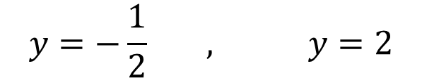




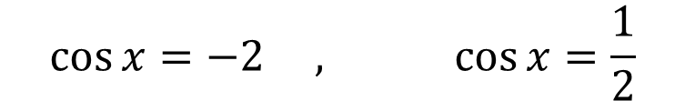



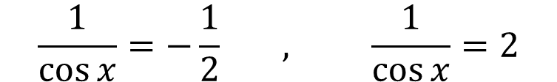


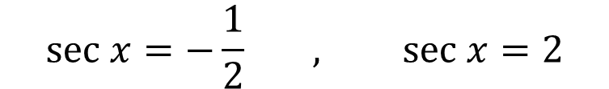
Sadler Ex 9E Q4
Solve $\left(\sec{x}\right)\left(3−\sec{x}\right)=\tan^{2}{x}−1, −180°≤x≤180°$
$$\left(\sec{x}\right)\left(3−\sec{x}\right)=\tan^{2}{x}−1$$
$$\tan^{2}{(θ)} +1=\sec^{2}{(θ)}$$
$$3\sec{x}−\sec^{2}{x}=\sec^{2}{x}−1−1$$
$$sec x=−\frac{1}{2} , sec x=2$$
$$0=−3\sec{x}+2\sec^{2}{x}−2$$
$$2\sec^{2}{x}−3\sec{x}−2=0$$
$$\frac{1}{\cos{x}}=−\frac{1}{2} , \frac{1}{\cos{x}}=2$$
Let $y=sec x$
$$2y^{2}−3y−2=0$$
$$\cos{x}=−2 , \cos{x}=\frac{1}{2}$$
$$2y^{2}−4y+y−2=0$$
$$2y\left(y−2\right)+(y−2)=0$$
(no solutions)
$$\left(2y+1\right)\left(y−2\right)=0$$
$$θ=±60°$$
$$y=−\frac{1}{2} , y=2$$

Slide 13
Sadler Ex 9E
Independent Practice

