Slide 1
Trigonometrical Identities
Trigonometric Graphs

Slide 2
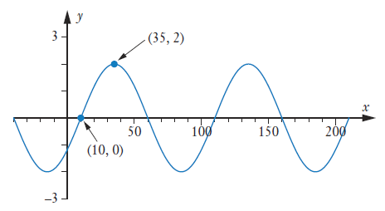











Guided Practice
Determine the graph on the right of the form
$$y=a(\sin{(b\left(x−c\right))}$$
Translated to the right by $10∴c=10$
Dilated parallel to y-axis by $2∴a=2$
$$y=2\sin{(b\left(x−10\right))}$$
Method 1:
Method 2:
Substitute $x=35,y=2, 2=2\sin{b(25)}$
Period $=100$
$$\sin\left(25b\right)=1$$
$$\frac{2π}{b}=100$$
$$25b=\frac{π}{2}$$
$$b=\frac{π}{50}$$
$$b=\frac{π}{50}$$
$$y=2\sin\left(\frac{π}{50}\left(x−10\right)\right)$$

Slide 3






Guided Practice
Determine the graph on the right of the form
$$y=a(\cos{(b\left(x−c\right))}$$
Translated to the right by $35∴c=35$
Dilated parallel to y-axis by $2∴a=2$
$$y=2\cos{(b\left(x−35\right))}$$
Period $=100$
$$\frac{2π}{b}=100$$
$$b=\frac{π}{50}$$
$$y=2\cos\left(\frac{π}{50}\left(x−35\right)\right)$$

Slide 4
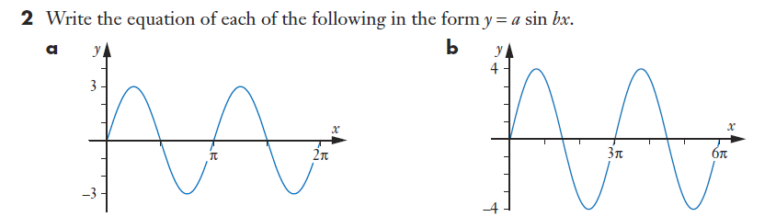


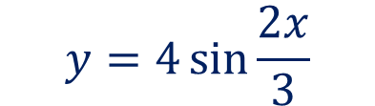







Sadler Ex 9H
Dilated parallel to y-axis by $3∴a=3$
Dilated parallel to y-axis by $4∴a=4$
Period $=π$
Period $=3π$
$$\frac{2π}{b}=π$$
$$\frac{2π}{b}=3π$$
$$b=2$$
$$b=\frac{2}{3}$$
$$y=3\sin{2x}$$
$$y=4\sin{\frac{2x}{3}}$$

Slide 5
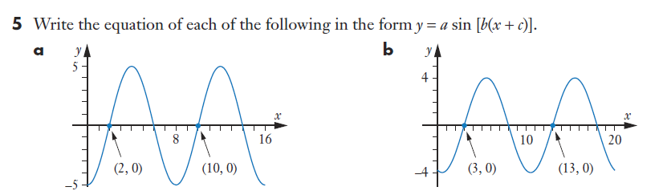
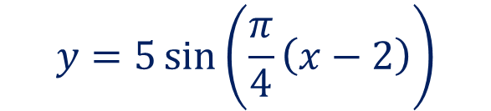










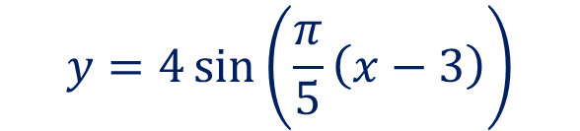
Sadler Ex 9H
Dilated parallel to y-axis by $5∴a=5$
Dilated parallel to y-axis by $4∴a=4$
Translated to the right by $2∴c=−2$
Translated to the right by $3∴c=−3$
Period $=10$
Period $=8$
$$\frac{2π}{b}=10$$
$$\frac{2π}{b}=8$$
$$b=\frac{π}{5}$$
$$b=\frac{π}{4}$$
$$y=4\sin\left(\frac{π}{5}\left(x−3\right)\right)$$
$$y=5\sin\left(\frac{π}{4}\left(x−2\right)\right)$$

Slide 6
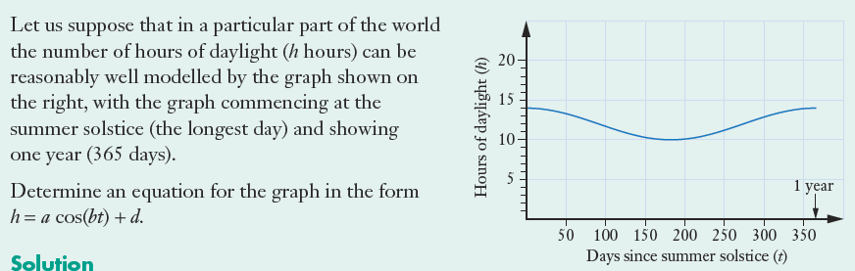









Guided Practice
Maximum value of graph $=14$
Minimum value of graph $=10$
Mean value of graph $=12$
$$∴d=12$$
Amplitude $a=2$
Period $=365$
$$\frac{2π}{b}=365$$
$$b=\frac{2π}{365}$$
$$∴y=2\cos\left(\frac{2π}{365}t\right)+12$$

Slide 7
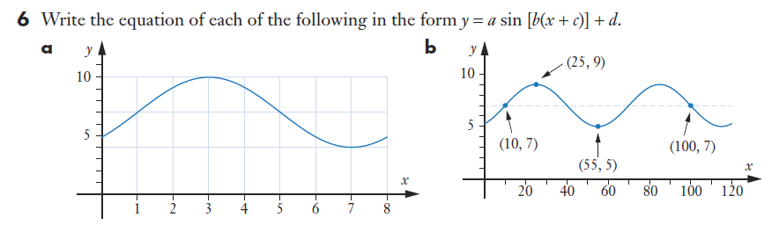



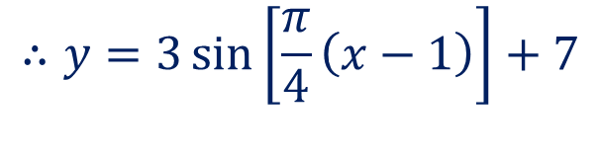






Sadler Ex 9H
Maximum value of graph $=10$
Minimum value of graph $=4$
Mean value of graph $=7$
$$∴d=7$$
Amplitude $a=3$
Period $=8$
$$\frac{2π}{b}=8$$
$$b=\frac{π}{4}$$
$$∴y=3\sin\left[\frac{π}{4}\left(x−1\right)\right]+7$$
Translated right by $1∴c=−1$

Slide 8



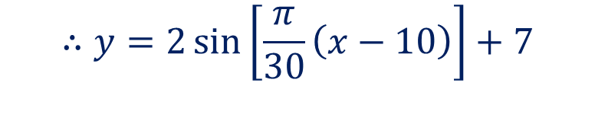




Sadler Ex 9H
Maximum value of graph $=9$
Minimum value of graph $=5$
Mean value of graph $=7$
$$∴d=7$$
Amplitude $a=2$
Period $=60$
$$\frac{2π}{b}=60$$
$$b=\frac{π}{30}$$
$$∴y=2\sin\left[\frac{π}{30}\left(x−10\right)\right]+7$$
Translated right by $10 ∴c=−10$

Slide 9
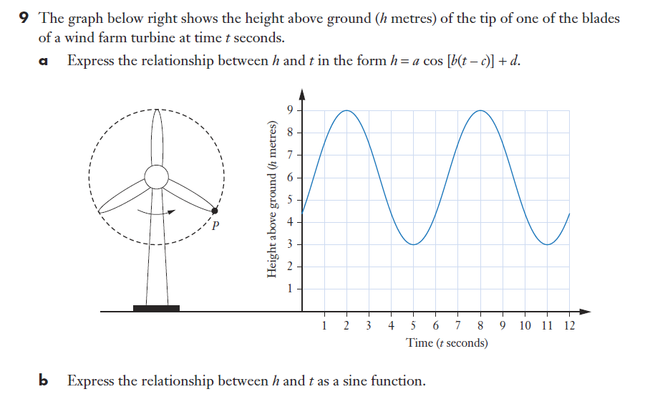











Sadler Ex 9H
Maximum value of graph $=9$
Minimum value of graph $=3$
Mean value of graph $=6$
$$∴d=6$$
Amplitude $a=3$
Translation to the right by 2 units, $c=2$
Period $=6$
$$\frac{2π}{b}=6$$
$$b=\frac{π}{3}$$
$$h=3\cos\left[\frac{π}{3}\left(t−2\right)\right]+6$$
$$h=3\sin\left[\frac{π}{3}\left(t−\frac{1}{2}\right)\right]+6$$

Slide 10
Sadler Ex 9H
Independent Practice

