Slide 1
Vectors
Components of Vectors

Slide 2
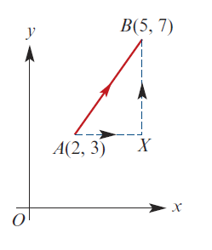


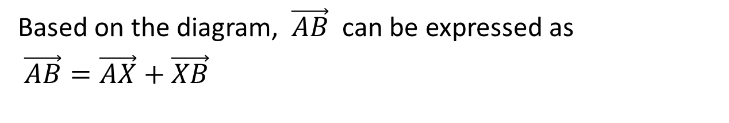
Component Vectors
Vector $\vec{AB}$ is describe by the column vector $\left[\begin{matrix}3 \\ 4\end{matrix}\right]$
Based on the diagram, $\vec{AB}$ can be expressed as
$\vec{AB}=\vec{AX}+\vec{XB}$
We can rewrite
$$\left[\begin{matrix}3 \\ 4\end{matrix}\right]=\left[\begin{matrix}3 \\ 0\end{matrix}\right]+\left[\begin{matrix}0 \\ 4\end{matrix}\right]$$

Slide 3
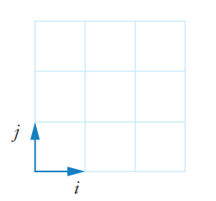
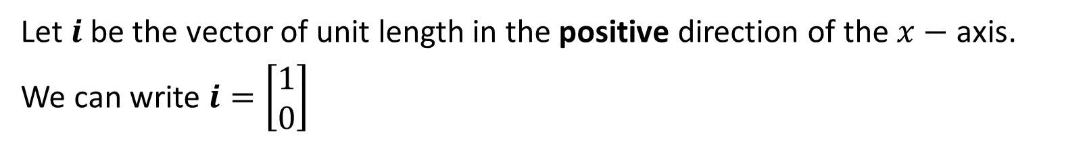
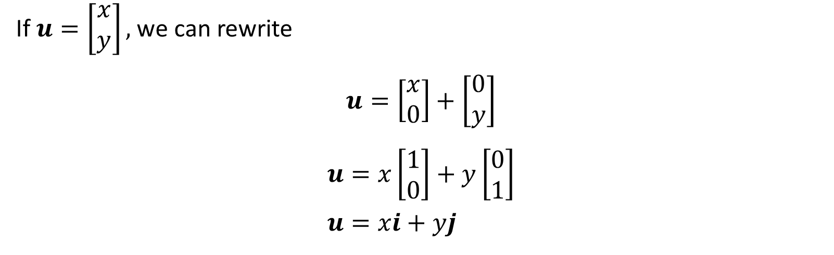
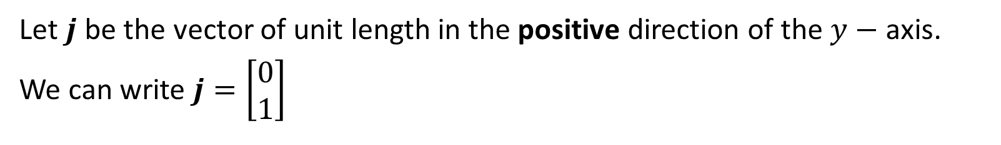
Component Vectors
Let $i$ be the vector of unit length in the positive direction of the $x−$ axis.
We can write $i=\left[\begin{matrix}1 \\ 0\end{matrix}\right]$
Let $j$ be the vector of unit length in the positive direction of the $y−$ axis.
We can write $j=\left[\begin{matrix}0 \\ 1\end{matrix}\right]$
If $u=\left[\begin{matrix}x \\ y\end{matrix}\right],$ we can rewrite
$$u=\left[\begin{matrix}x \\ 0\end{matrix}\right]+\left[\begin{matrix}0 \\ y\end{matrix}\right]$$
$$u=x\left[\begin{matrix}1 \\ 0\end{matrix}\right]+y\left[\begin{matrix}0 \\ 1\end{matrix}\right] \\ u=xi+yj$$

Slide 4
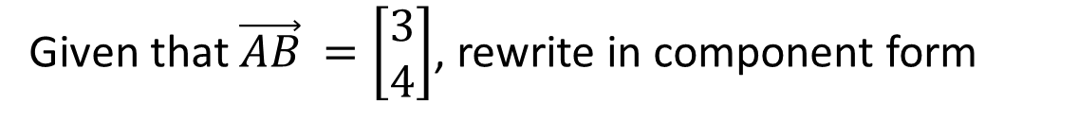


Example
Given that $\vec{AB}$ $=\left[\begin{matrix}3 \\ 4\end{matrix}\right]$, rewrite in component form
We can rewrite
$$\left[\begin{matrix}3 \\ 4\end{matrix}\right]=\left[\begin{matrix}3 \\ 0\end{matrix}\right]+\left[\begin{matrix}0 \\ 4\end{matrix}\right]$$
$$\vec{AB}=3i+4j$$

Slide 5
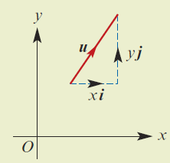
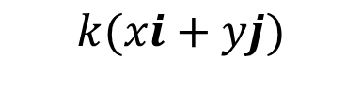
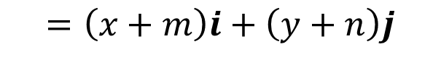


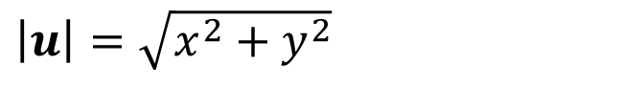

Magnitude of Vectors
We can write $u=\left[\begin{matrix}x \\ y\end{matrix}\right],$ as $u=xi+yj$
The magnitude of vector $u$, is denoted by $|u|$
$\left|u\right|=\sqrt{x^{2}+y^{2}}$
Operations of Component Vectors
$$\left(xi+yj\right)+(mi+nj)$$
$$=\left(x+m\right)i+\left(y+n\right)j$$
$$k(xi+yj)$$
$$=kxi+kyj$$

Slide 6
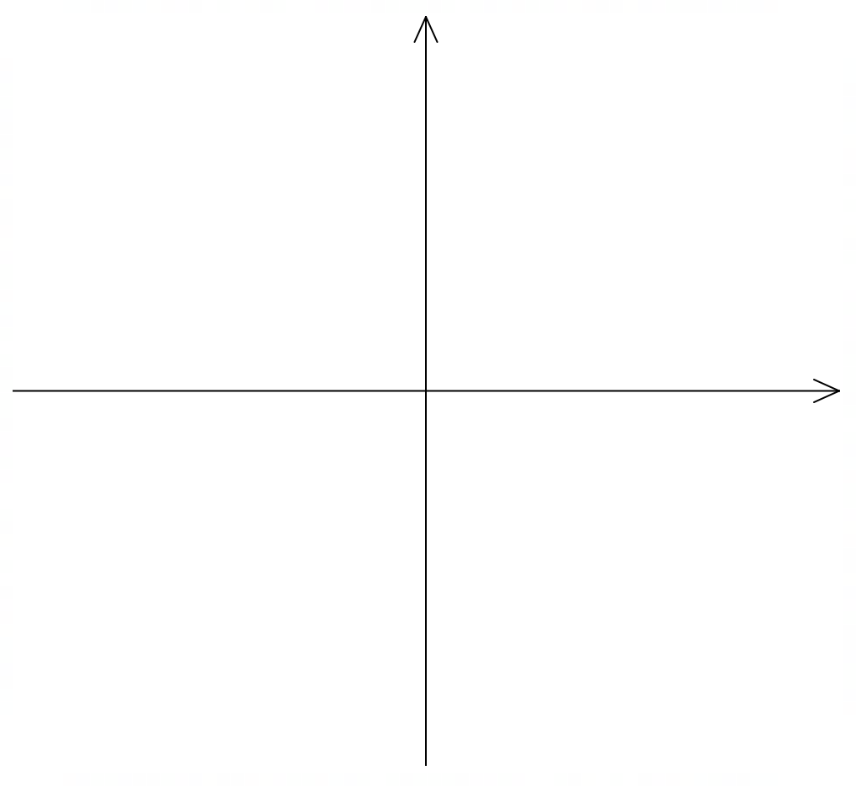







Cambridge 17B Ex 7
Find $\vec{AB}$ if $\vec{OA}=3i$ and $\vec{OB}=2i−j$
Find $|2i−3j|$
$\vec{AB}=\vec{AO}+\vec{OB}$
$$=−\vec{OA}+\vec{OB}$$
$$=−3i+2i−j$$
$$=−i−j$$
$\left|2i−3j\right|=\sqrt{{(2)}^{2}+{\left(−3\right)}^{2}}$
$$=\sqrt{4+9}$$
$$=\sqrt{13}$$

Slide 7






Cambridge 17B Ex 8
Let $A$ and $B$ be points on the Cartesian plane such that $\vec{OA}=2i+j$ and $\vec{OB}=i−3j$
Find $\vec{AB}$ and $|\vec{AB}|$
$\vec{AB}=\vec{AO}+\vec{OB}$
$$=−\vec{OA}+\vec{OB}$$
$\vec{AB}=−\left(2i+j\right)+i−3j$
$$=−i−4j$$
$\left|\vec{AB}\right|=\sqrt{{\left(−1\right)}^{2}+{\left(−4\right)}^{2}}$
$$=\sqrt{1+16}$$
$$=\sqrt{17}$$

Slide 8
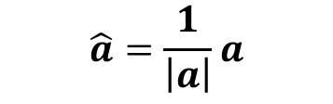
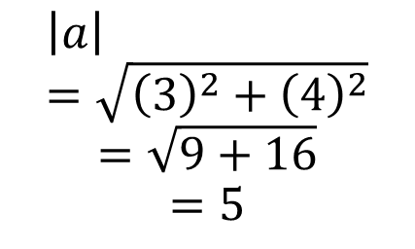

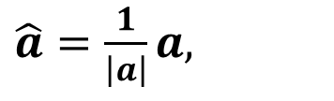

Unit Vectors
A unit vector is a vector with magnitude = 1
Both $i$ and $j$ are unit vectors
The unit vector in the direction of $a$ is denoted by $\hat{a}$
Since $\left|\hat{a}\right|=1,$
$\left|a\right|\hat{a}=a,$
$\hat{a}=\frac{1}{\left|a\right|}a,$
Cambridge Ch 17B Ex 9
Let $a=3i+4j$
Find $|a|$, the magnitude of $a$, hence find the unit vector in the direction of $a$
$$\left|a\right|=\sqrt{{\left(3\right)}^{2}+{\left(4\right)}^{2}}$$
$$=\sqrt{9+16}$$
$$=5$$
$$\hat{a}=\frac{1}{\left|a\right|}a$$
$$=\frac{1}{5}\left(3i+4j\right)$$

Slide 9
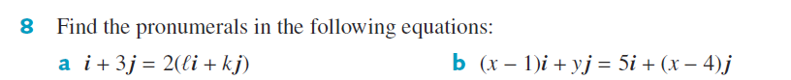
Cambridge 17B Q 8

Slide 10

Cambridge 17B Q4

Slide 11

Cambridge 17B Q11

Slide 12
Cambridge 17B Q11

Slide 13
Cambridge 17B Q11

Slide 14
Cambridge 17B Q12

Slide 15
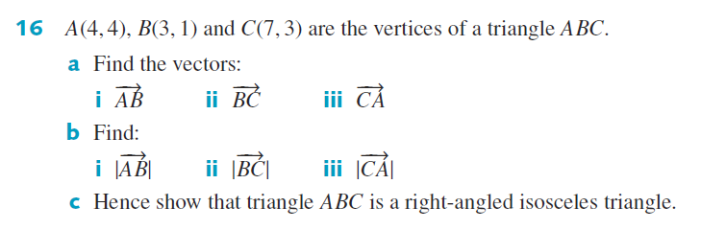
Cambridge 17B Q16

Slide 16
Cambridge 17B Q16

Slide 17
Independent practice
Cambridge Ex 17B

