Slide 1
Vectors
Vector Projection

Slide 2
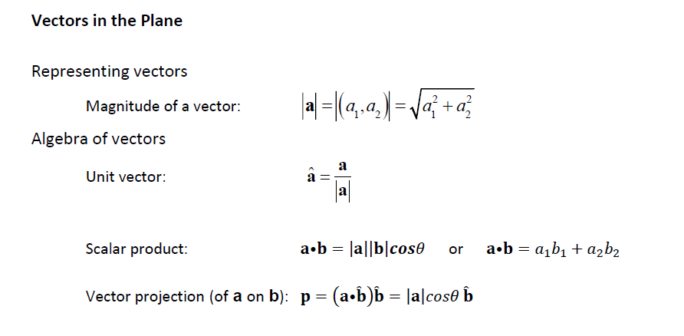






Cambridge 17D Q1

Slide 3
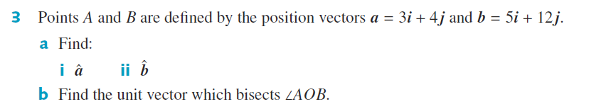










Cambridge 17D Q3

Slide 4


Cambridge 17D Q3

Slide 5
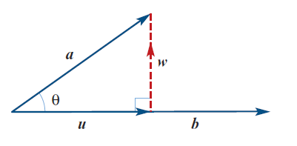

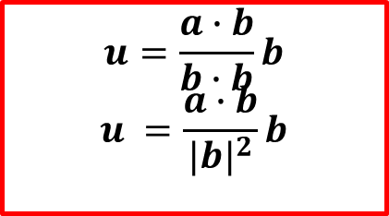





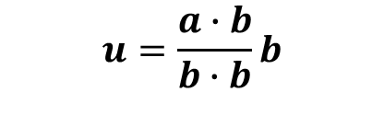
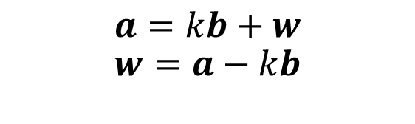

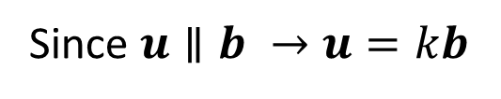

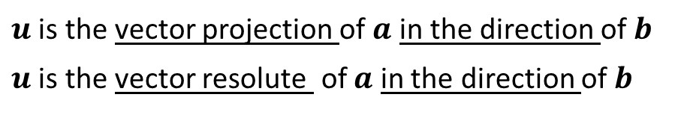
Vector Projection
From the diagram,
$$a=u+w$$
Since $u∥b →u=kb$
$$a=kb+w$$
$$w=a−kb$$
Since $w ⊥b→w∙b=0$
$$u=\frac{a∙b}{b∙b}b$$
$$u =\frac{a∙b}{{|b|}^{2}}b$$
$$\left(a−kb\right)∙b=0$$
$$a∙b−kb∙b=0$$
$$a∙b=kb∙b$$
$u$ is the vector projection of $a$ in the direction of $b$
$u$ is the vector resolute of $a$ in the direction of $b$
$$k=\frac{a∙b}{b∙b}$$
$$u=\frac{a∙b}{b∙b}b$$
We say that $u$ is the vector projection of $a$ in the direction of $b$

Slide 6





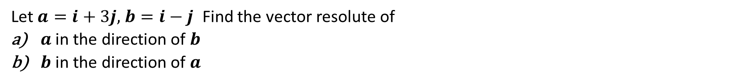

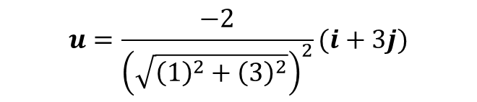
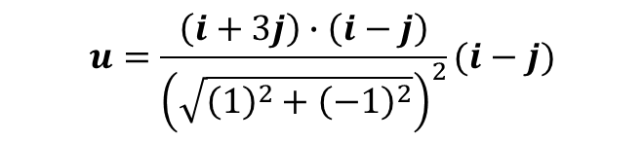



Cambridge 17D Ex 12
$$u=\frac{a∙b}{b∙b}b$$
$$u =\frac{a∙b}{{|b|}^{2}}b$$
Let$a=i+3j,$ $b=i−j$ Find the vector resolute of
$a$ in the direction of $b$
$b$ in the direction of $a$
$$u=\frac{a∙b}{b∙b}b$$
$$u=\frac{b∙a}{a∙a}a$$
$$u=\frac{\left(i+3j\right)∙\left(i−j\right)}{{\left(\sqrt{{\left(1\right)}^{2}+{\left(−1\right)}^{2}}\right)}^{2}}(i−j)$$
$$u=\frac{−2}{{\left(\sqrt{{\left(1\right)}^{2}+{\left(3\right)}^{2}}\right)}^{2}}(i+3j)$$
$$u=\frac{\left(1\right)\left(1\right)+(3)(−1)}{2}(i−j)$$
$$u=\frac{−2}{10}(i+3j)$$
$$u=\frac{−2}{2}(i−j)$$
$$u=\frac{−1}{5}(i+3j)$$
$$u=−1(i−j)$$
$$u=−i+j$$

Slide 7

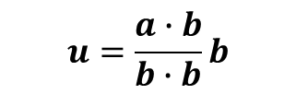
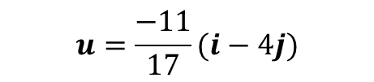
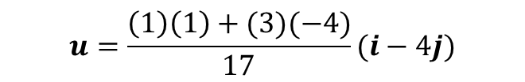
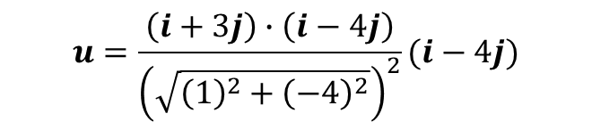
Cambridge 17D Q4
$$u=\frac{a∙b}{b∙b}b$$
$$u=\frac{\left(i+3j\right)∙\left(i−4j\right)}{{\left(\sqrt{{\left(1\right)}^{2}+{\left(−4\right)}^{2}}\right)}^{2}}(i−4j)$$
$$u=\frac{\left(1\right)\left(1\right)+(3)(−4)}{17}(i−4j)$$
$$u=\frac{−11}{17}(i−4j)$$

Slide 8
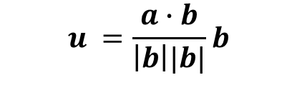



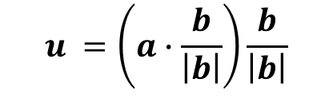
Vector Projection
$$u =\frac{a∙b}{\left|b\right||b|}b$$
$$u =\left(a∙\frac{b}{\left|b\right|}\right)\frac{b}{\left|b\right|}$$
$u =\left(a∙\hat{b}\right)$ $\hat{b}$
The scalar resolute of $a$ in the direction of $b$ = $a∙\hat{b}=a∙\frac{b}{\left|b\right|}$

Slide 9
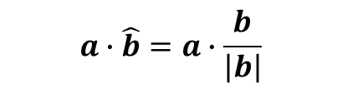




Cambridge 17D Ex 13
Find the scalar resolute of $a=2i+2j$ in the direction $b=−i+3j$
$$a∙\hat{b}=a∙\frac{b}{\left|b\right|}$$
$$=\frac{\left(2i+2j\right)∙\left(−1i+3j\right)}{{\left(\sqrt{{\left(−1\right)}^{2}+{\left(3\right)}^{2}}\right)}^{ }}$$
$$=\frac{\left(2\right)\left(−1\right)+(2)(3)}{\sqrt{10}}$$
$$=\frac{4}{\sqrt{10}}=\frac{2\sqrt{10}}{5}$$

Slide 10
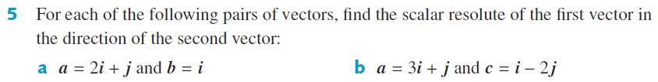
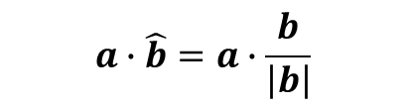



Cambridge 17D Q5
$$a∙\hat{b}=a∙\frac{b}{\left|b\right|}$$
$$=\frac{\left(2i+j\right)∙\left(i+0j\right)}{{\left(\sqrt{{\left(1\right)}^{2}+{\left(0\right)}^{2}}\right)}^{ }}$$
$$=\frac{\left(2\right)\left(1\right)+(1)(0)}{\sqrt{1}}$$
$$=2$$

Slide 11
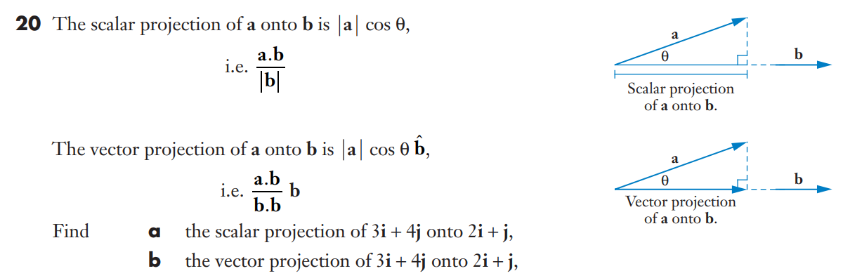





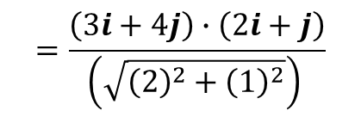
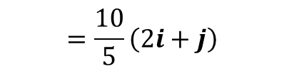

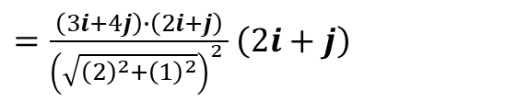
Sadler 8B Q20
$$=\frac{\left(3i+4j\right)∙\left(2i+j\right)}{{\left(\sqrt{{\left(2\right)}^{2}+{\left(1\right)}^{2}}\right)}^{ }}$$
$$\frac{a∙b}{b∙b}b$$
$=\frac{\left(3i+4j\right)∙\left(2i+j\right)}{{{\left(\sqrt{{\left(2\right)}^{2}+{\left(1\right)}^{2}}\right)}^{2}}^{ }}$ $\left(2i+j\right)$
$$a∙\hat{b}$$
$$=\frac{\left(3\right)\left(2\right)+(4)(1)}{\sqrt{5}}$$
$$=\frac{10}{5}\left(2i+j\right)$$
$$=\frac{10}{\sqrt{5}}=2\sqrt{5}$$
$$=2\left(2i+j\right)$$
$$=4i+2j$$

Slide 12
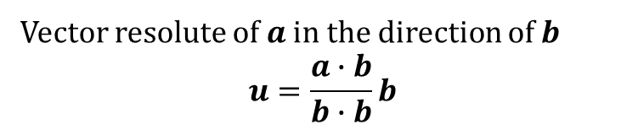
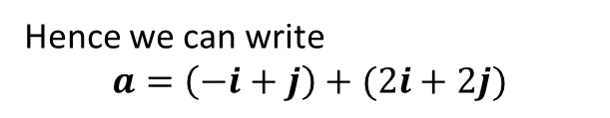


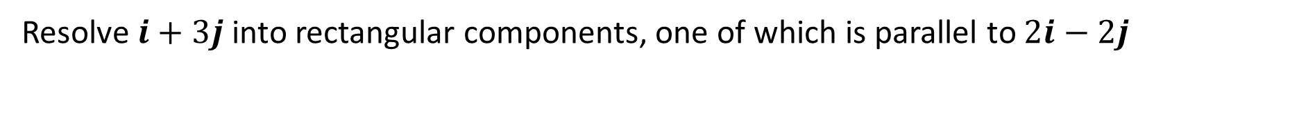


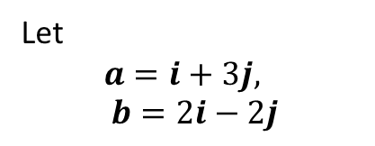
Cambridge 17D Ex 14
Resolve $i+3j$ into rectangular components, one of which is parallel to $2i−2j$
Let
$$a=i+3j, b=2i−2j$$
Vector resolute of $a$ in the direction of $b$
$$u=\frac{a∙b}{b∙b}b$$
$$u=\frac{\left(1\right)\left(2\right)+\left(3\right)\left(−2\right)}{{\left(2\right)}^{2}+{\left(−2\right)}^{2}}(2i−2j)$$
$$u=−\frac{1}{2}\left(2i−2j\right)=−i+j$$
$$w=−u+a$$
$$w=i−j+i+3j=2i+2j$$
Hence we can write
$$a=\left(−i+j\right)+(2i+2j)$$

Slide 13
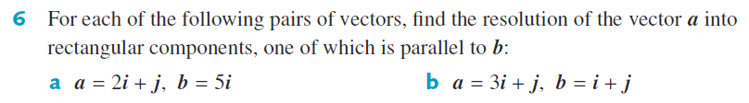










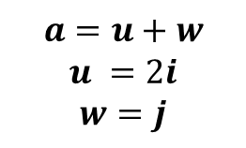


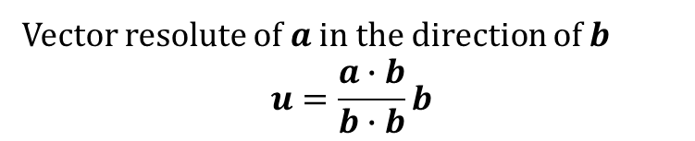



Cambridge 17D Q6
Vector resolute of $a$ in the direction of $b$
$$u=\frac{a∙b}{b∙b}b$$
$$u=\frac{\left(2\right)\left(5\right)+\left(1\right)\left(0\right)}{5^{2}}(5i)$$
$$u=\frac{\left(3\right)\left(1\right)+\left(1\right)\left(1\right)}{1^{2}+1^{2}}(i+j)$$
$$u=\frac{10}{25}(5i)$$
$$u=2(i+j)$$
$$u=2i$$
$$w=−u+a$$
$$w=−u+a$$
$$w=−2i−2j+3i+j$$
$$w=i−j$$
$$w=−2i+2i+j$$
$$w=j$$
$$a=u+w$$
$$a=u+w$$
$$u =2i$$
$$w=j$$
$$a=2\left(i+j\right)+i−j$$
$$u=2(i+j)$$
$$w=i−j$$

Slide 14
Independent practice
Cambridge Ex 17D

