Slide 1
Vectors
Geometric Vector Proofs

Slide 2
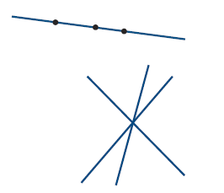
Vocabulary
Collinear Points:
Three or more points are collinear if they all lie on the same single line
Concurrent Points:
Three or more lines are concurrent if they all pass through a single point.

Slide 3
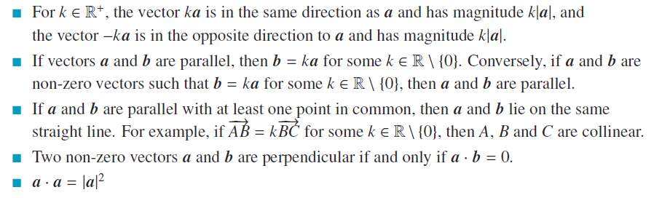
Useful properties to know
Collinear Points:
Three or more points are collinear if they all lie on the same single line

Slide 4
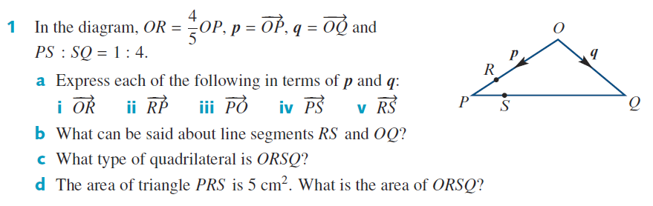


Cambridge 17E Q1

Slide 5


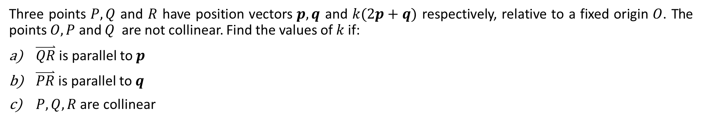
Cambridge 17E Ex 15
Three points $P, Q$ and $R$ have position vectors $p, q$ and $k(2p+q)$ respectively, relative to a fixed origin $O$. The points $O, P$ and $Q$ are not collinear. Find the values of $k$ if:
$\overset{⃑}{QR}$ is parallel to $p$
$\overset{⃑}{PR}$ is parallel to $q$
$P, Q, R$ are collinear

Slide 6
Cambridge 17E Ex 15
Three points $P, Q$ and $R$ have position vectors $p, q$ and $k(2p+q)$ respectively, relative to a fixed origin $O$. The points $O, P$ and $Q$ are not collinear. Find the values of $k$ if:
$\overset{⃑}{QR}$ is parallel to $p$
$\overset{⃑}{PR}$ is parallel to $q$
$P, Q, R$ are collinear

Slide 7
Cambridge 17E Ex 15
Three points $P, Q$ and $R$ have position vectors $p, q$ and $k(2p+q)$ respectively, relative to a fixed origin $O$. The points $O, P$ and $Q$ are not collinear. Find the values of $k$ if:
$\overset{⃑}{QR}$ is parallel to $p$
$\overset{⃑}{PR}$ is parallel to $q$
$P, Q, R$ are collinear

Slide 8
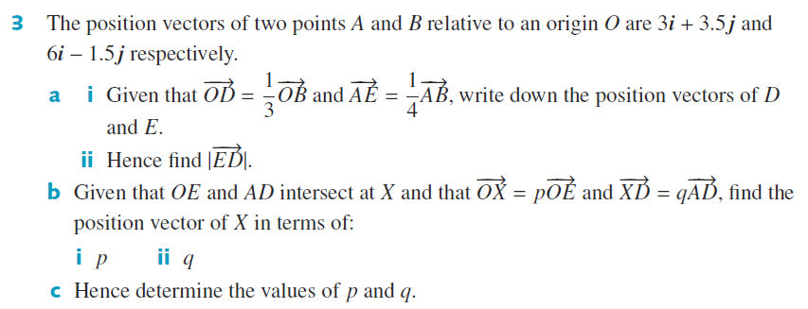





Cambridge 17E Q3

Slide 9

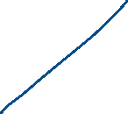



Cambridge 17E Q3

Slide 10
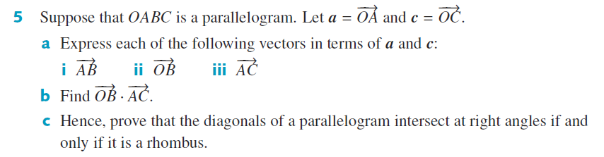



Cambridge 17E Q5

Slide 11



Cambridge 17E Q5

Slide 12




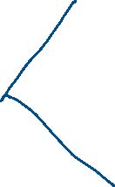


Cambridge 17E Q7

Slide 13





Cambridge 17E Q7

Slide 14


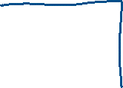


Cambridge 17E Q8

Slide 15


Cambridge 17E Q8

Slide 16






Cambridge 17E Q8

Slide 17
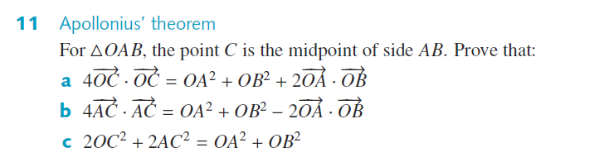




Cambridge 17E Q11

Slide 18



Cambridge 17E Q11

Slide 19





Cambridge 17E Q11

Slide 20
Independent practice
Cambridge Ex 17E

