Slide 1
Vectors
Applications of Vectors

Slide 2
REVIEW: Introduction to Vectors
In the study of vectors, we are constructing diagrams very similar to those we have seen for bearings in Trigonometry. However, we use the following terminology and concepts to describe vectors:
When we draw vectors, they are represented by arrows to show direction:
When we ADD/SUBTRACT vectors together, we use the ‘head-to-tail’ method.
After drawing the first vector, the head of the first vector must meet the tail of the second vector
The addition of vectors produces a final vector called the RESULTANT. The resultant’s head is always meeting the head of the second vector.
The original directions of the vectors MUST be maintained.
There is more than one possible diagram that can be drawn.
2nd vector
1st vector
Resultant

Slide 3
EXAMPLE 1 (Q1 & 2 from Sadler Ex 3C)
Find the resultant of each of the following pairs of velocities stating the magnitude of the resultant, correct to one decimal place, and the acute angle it makes with the bank, to the nearest degree.

Slide 4
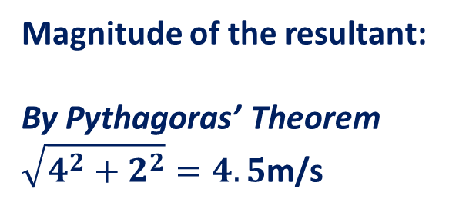
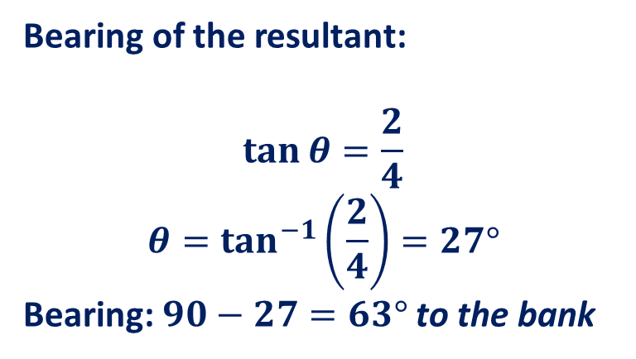
EXAMPLE 1 (Q1 & 2 from Sadler Ex 3C)
Find the resultant of each of the following pairs of velocities stating the magnitude of the resultant, correct to one decimal place, and the acute angle it makes with the bank, to the nearest degree.
2m/s
Magnitude of the resultant:
By Pythagoras’ Theorem
$\sqrt{4^{2}+2^{2}}=4.5$m/s
4m/s
Resultant
θ
Bearing of the resultant:
$$\tan{θ=\frac{2}{4}}$$
$$θ=\tan^{−1}\left(\frac{2}{4}\right)=27°$$
Bearing: $90−27=63°$ to the bank
Bank

Slide 5

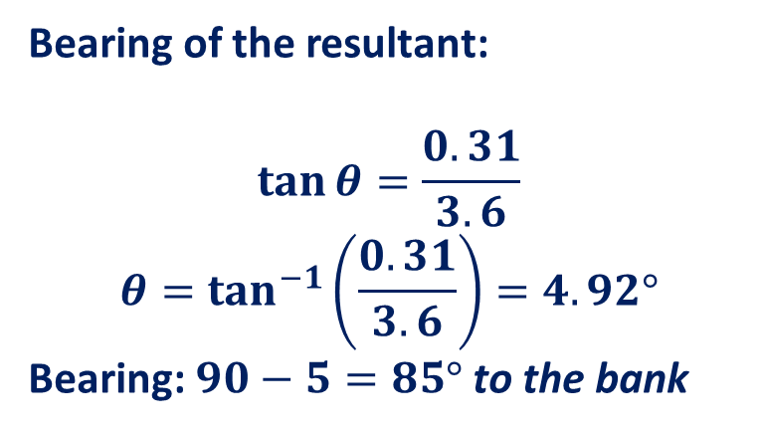
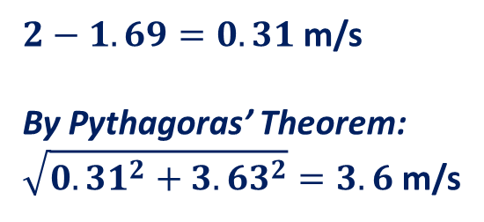

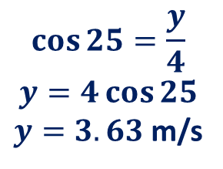

EXAMPLE 1 (Q1 & 2 from Sadler Ex 3C)
Find the resultant of each of the following pairs of velocities stating the magnitude of the resultant, correct to one decimal place, and the acute angle it makes with the bank, to the nearest degree.
$$x$$
2m/s
$$y$$
Resultant
4m/s
25˚
θ
Bank
Bearing of the resultant:
$$\tan{θ=\frac{0.31}{3.6}}$$
$$θ=\tan^{−1}\left(\frac{0.31}{3.6}\right)=4.92°$$
Bearing: $90−5=85°$ to the bank
Magnitude of the resultant:
In the LHS triangle:
$$\sin{25}=\frac{x}{4}$$
$$x=4\sin{25}$$
$x=1.69$ m/s
$2−1.69=0.31$ m/s
By Pythagoras’ Theorem:
$\sqrt{{0.31}^{2}+{3.63}^{2}}=3.6$ m/s
$$\cos{25}=\frac{y}{4}$$
$$y=4\cos{25}$$
$y=3.63$m/s

Slide 6

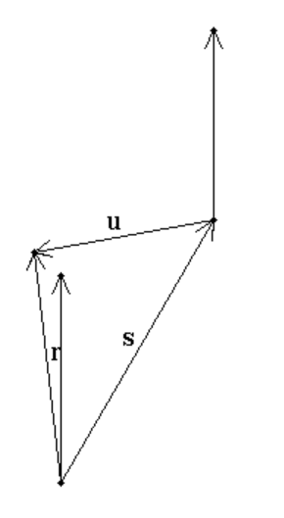




Sadler 3C Q4

Slide 7
Applications of Vectors
Vectors are used to describe situations where one force is acting against another force. One example includes situations involving velocity.
Question 9 of Exercise 3C:
‘In still air an aircraft can maintain a speed of 300km/hr. In what direction should the aircraft be pointing if it is to travel due north and a wind of 28km/hr is blowing from 070°?’
Still air means there is no wind.
Therefore the plane can fly at a speed of 300km/hr when there is no wind.
The wind is blowing FROM 070°. Pay attention to the way the arrow is pointing – it is pointing inwards because the wind is blowing FROM 70˚, not in the direction of 70˚.
The head-to-tail diagram for the situation above looks like the one shown to
the right.
North
28km/h
70°
300km/h
θ °

Slide 8
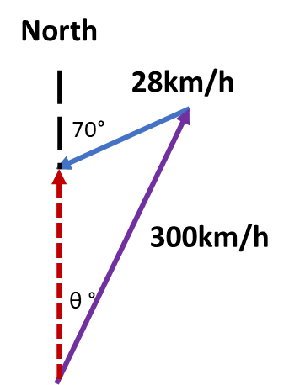

EXAMPLE 2 (Q9 from Sadler Ex 3C)
In still air an aircraft can maintain a speed of 300km/hr. In what direction should the aircraft be pointing if it is to travel due north and a wind of 28km/hr is blowing from 070°?
$$180−70=110°$$
Using the Sine Rule:
$$\frac{300}{sin 110}=\frac{28}{sin θ}$$
$$θ=5.03°$$
The bearing of the aircraft should be $005°$
110˚

Slide 9
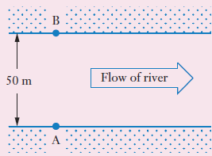







Sadler 3C Example 4
A canoeist wishes to paddle her canoe across a river from point A on one bank to the opposite bank. The canoeist can maintain a constant 5km/h in still water. However, the river is flowing at 3 km/h.
If the canoeist wishes to journey across the river as quickly as possible, how long will the journey take and how far down will the canoeist travel?
If instead, she wishes to reach point B on the opposite bank, directly opposite A, in which direction should she paddle and how long will the journey take?

Slide 10






Sadler 3C Example 4
A canoeist wishes to paddle her canoe across a river from point A on one bank to the opposite bank. The canoeist can maintain a constant 5km/h in still water. However, the river is flowing at 3 km/h.
If the canoeist wishes to journey across the river as quickly as possible, how long will the journey take and how far down will the canoeist travel?
If instead, she wishes to reach point B on the opposite bank, directly opposite A, in which direction should she paddle and how long will the journey take?

Slide 11
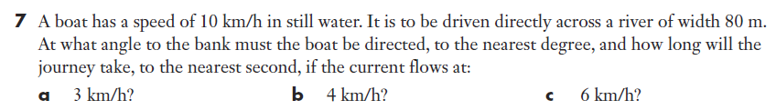






Sadler 3C Q7

