Slide 1
Vectors
Representing Vector Quantities

Slide 2
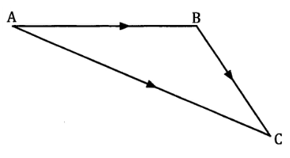
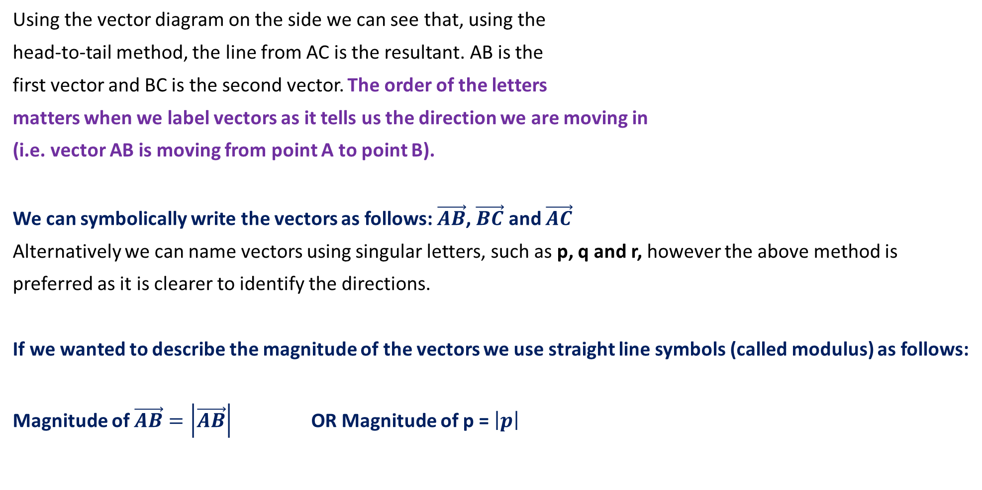
Notations for Vectors
Using the vector diagram on the side we can see that, using the
head-to-tail method, the line from AC is the resultant. AB is the
first vector and BC is the second vector. The order of the letters
matters when we label vectors as it tells us the direction we are moving in
(i.e. vector AB is moving from point A to point B).
We can symbolically write the vectors as follows: $\vec{AB}$, $\vec{BC}$ and $\vec{AC}$
Alternatively we can name vectors using singular letters, such as p, q and r, however the above method is
preferred as it is clearer to identify the directions.
If we wanted to describe the magnitude of the vectors we use straight line symbols (called modulus) as follows:
Magnitude of $\vec{AB}=\left|\vec{AB}\right|$ OR Magnitude of p = $\left|p\right|$
p
q
r

Slide 3
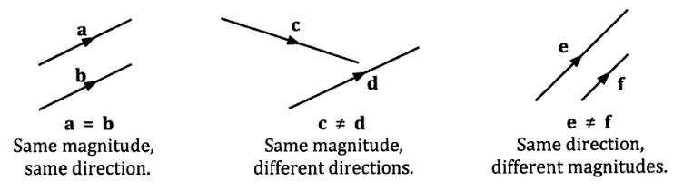
Equal Vectors
Vectors are equal if they have the same magnitude and direction (see first diagram).
All others are considered different. Some vectors can be considered ‘like’ or ‘unlike’ depending on whether they share the same direction or not.

Slide 4
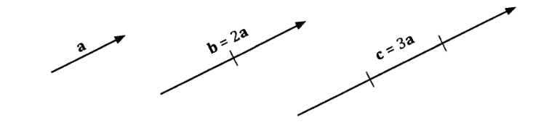
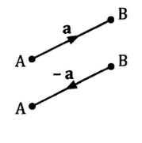

Multiplying Scalars to Vectors
If b = 2a, then b is twice the magnitude of the vector a.
If c = 3a, then c is three times the magnitude of the vector a.
If $\vec{AB}$ is multiplied by -1, so that it becomes $−\vec{AB},$ it has the same magnitude but the opposite direction of the original vector.

Slide 5
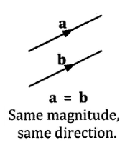
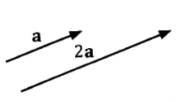

Parallel Vectors
Two vectors are parallel if one is the scalar multiple of the other.
They are ‘like’ when:
They have the same magnitude and direction
They have the same magnitude but different scalar quantities. 2a is twice
the length of a.
They are ‘unlike’ when:
They are in opposite directions, because one vector is multiplied by a negative scalar.
Same direction,
different scale.
Negated direction

Slide 6
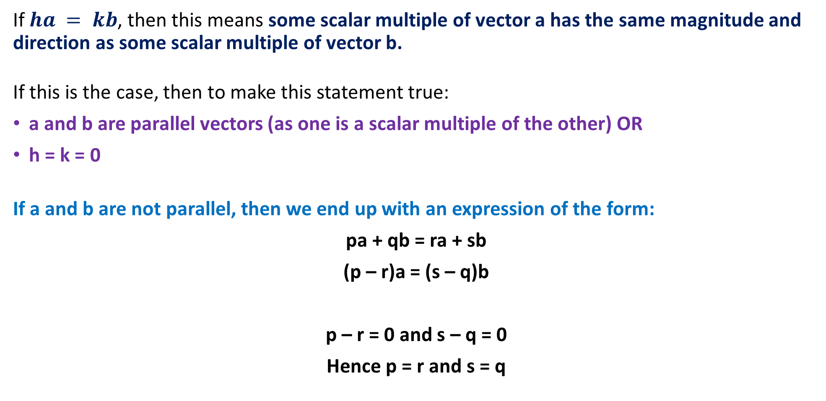
Parallel Vectors ha = kb
If $ha = kb$, then this means some scalar multiple of vector a has the same magnitude and direction as some scalar multiple of vector b.
If this is the case, then to make this statement true:
a and b are parallel vectors (as one is a scalar multiple of the other) OR
h = k = 0
If a and b are not parallel, then we end up with an expression of the form:
pa + qb = ra + sb
(p – r)a = (s – q)b
p – r = 0 and s – q = 0
Hence p = r and s = q

Slide 7

Sadler Ex 3D Example 6
ABCD is a parallelogram with $\vec{AB}=a$ and $\vec{AD}=b$. E is a point on BC such that BE:EC = 1:2 and F is a point on CD such that CF:CD = 1:2. Express each of the following in terms of a and/or b.
a)$\vec{AC}$
b) $\vec{BE}$
c) $\vec{DF}$
d) $\vec{AE}$
e) $\vec{AF}$
f) $\vec{BF}$
g) $\vec{DE}$
h) $\vec{EF}$
E
B
C
a
F
A
D
b
ALWAYS construct the diagram first!
Note that the ratio BE:EC states that
BE is half the size of EC, and CF:CD
states that CF is half the size of CD.

Slide 8
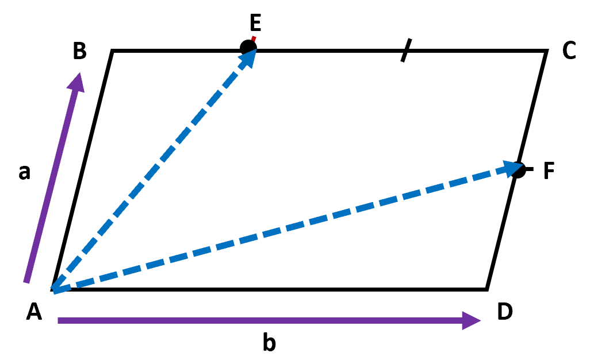



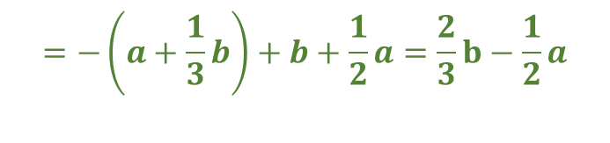



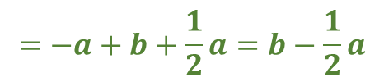
Sadler Ex 3D Example 6
ABCD is a parallelogram with $\vec{AB}=a$ and $\vec{AD}=b$. E is a point on BC such that BE:EC = 1:2 and F is a point on CD such that CF:CD = 1:2. Express each of the following in terms of a and/or b.
a)$\vec{AC}$
b) $\vec{BE}$
c) $\vec{DF}$
d) $\vec{AE}$
e) $\vec{AF}$
f) $\vec{BF}$
g) $\vec{DE}$
h) $\vec{EF}$
$$= b + a$$
$=$ $\frac{1}{3}b$
$=$ $\frac{1}{2}a$
$$=a+\frac{1}{3}b$$
$$=b+\frac{1}{2}a$$
$$=−a+b+\frac{1}{2}a=b−\frac{1}{2}a$$
$$=a−\frac{2}{3}b$$
$$=−\left(a+\frac{1}{3}b\right)+b+\frac{1}{2}a=\frac{2}{3}b−\frac{1}{2}a$$

Slide 9
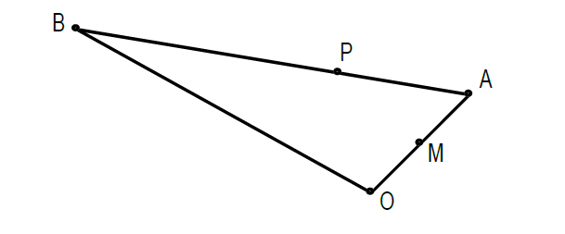

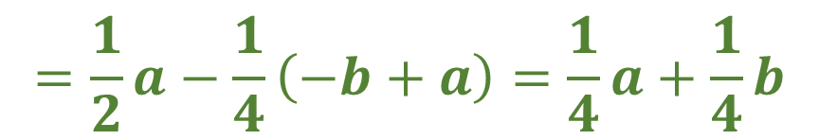
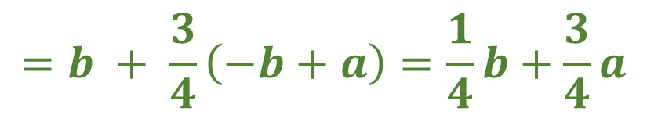

Exam Paper – Calc Assumed
In the triangle below, $\vec{OA}=a$ and $\vec{OB}=b$. $M$ is the midpoint of $OA$ and $P$ is a point on $AB$ such that $\vec{AP}$: $\vec{PB}=1:3$.
Express each of the following in terms of $a$ and/or $b$.
a) $\vec{BA}$
b) $\vec{OP}$
c) $\vec{MP}$
$$=−b + a$$
$$=b + \frac{3}{4}\left(−b+a\right)=\frac{1}{4}b+\frac{3}{4}a$$
$$=\frac{1}{2}a−\frac{1}{4}\left(−b+a\right)=\frac{1}{4}a+\frac{1}{4}b$$

Slide 10


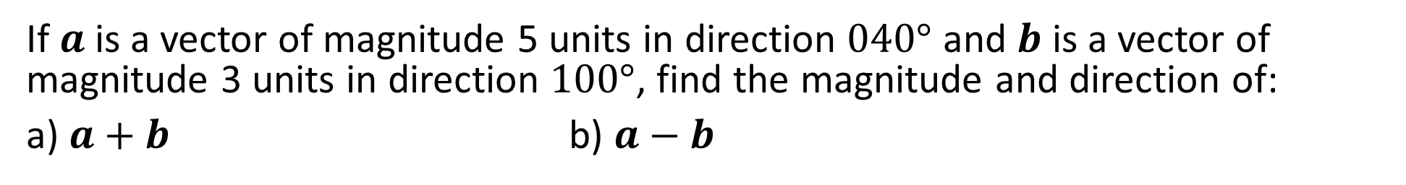



Sadler 3D Example 5
If $a$ is a vector of magnitude 5 units in direction $040°$ and $b$ is a vector of magnitude 3 units in direction $100°$, find the magnitude and direction of:
a) $a+b$ b) $a−b$

Slide 11
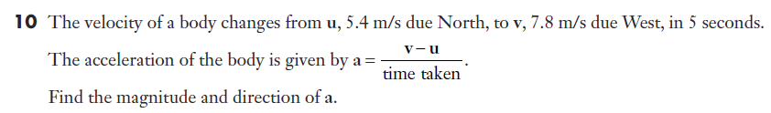


Sadler 3D Q10

