Slide 1
Vectors
Components of Vectors

Slide 2
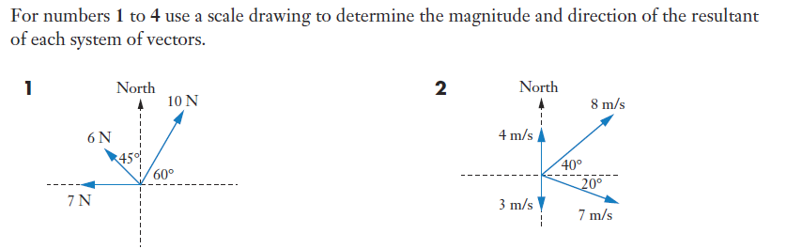
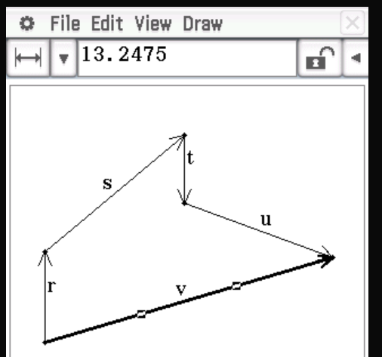
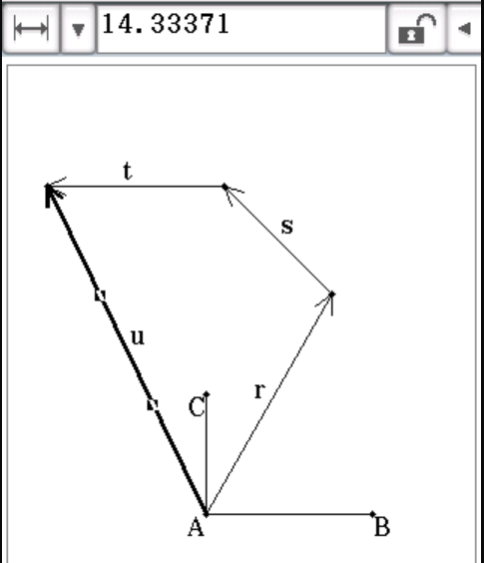







Sadler 4A Q1 - 2

Slide 3
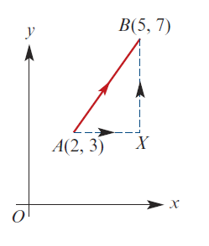


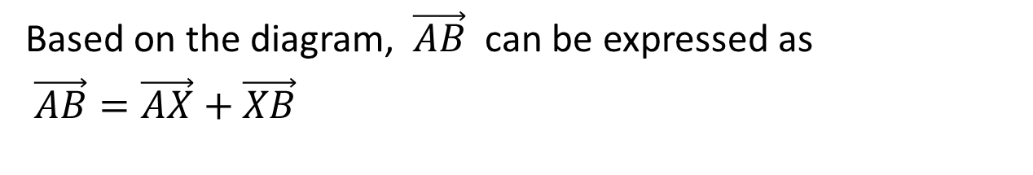
Recap
Vector $\vec{AB}$ is describe by the column vector $\left[\begin{matrix}3 \\ 4\end{matrix}\right]$
Based on the diagram, $\vec{AB}$ can be expressed as
$\vec{AB}=\vec{AX}+\vec{XB}$
We can rewrite
$$\left[\begin{matrix}3 \\ 4\end{matrix}\right]=\left[\begin{matrix}3 \\ 0\end{matrix}\right]+\left[\begin{matrix}0 \\ 4\end{matrix}\right]$$

Slide 4
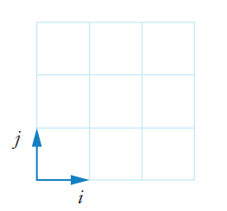
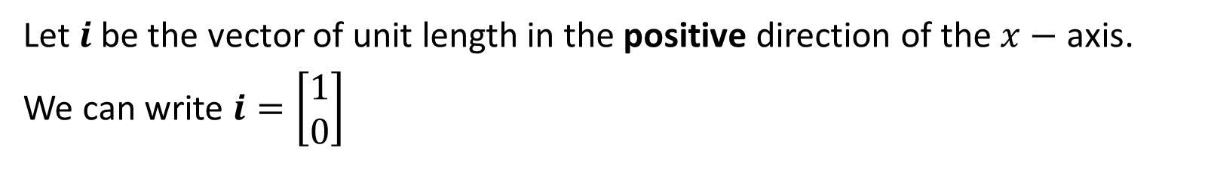
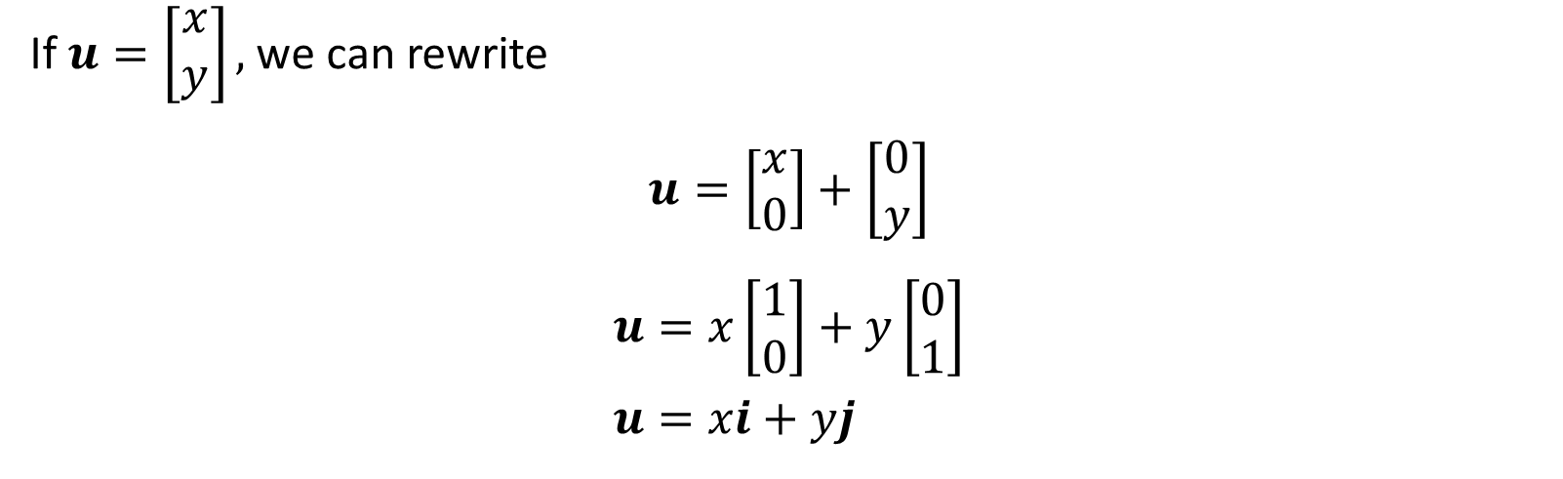
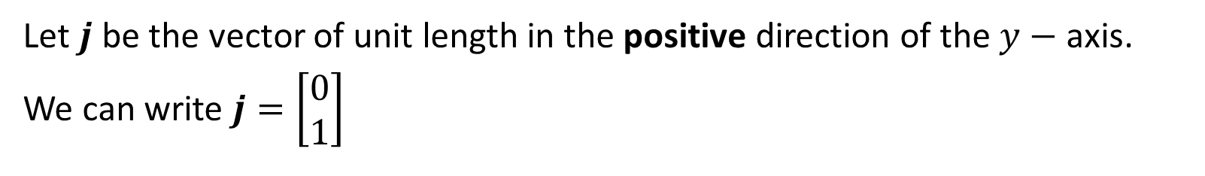
Component Vectors
Let $i$ be the vector of unit length in the positive direction of the $x−$ axis.
We can write $i=\left[\begin{matrix}1 \\ 0\end{matrix}\right]$
Let $j$ be the vector of unit length in the positive direction of the $y−$ axis.
We can write $j=\left[\begin{matrix}0 \\ 1\end{matrix}\right]$
If $u=\left[\begin{matrix}x \\ y\end{matrix}\right],$ we can rewrite
$$u=\left[\begin{matrix}x \\ 0\end{matrix}\right]+\left[\begin{matrix}0 \\ y\end{matrix}\right]$$
$$u=x\left[\begin{matrix}1 \\ 0\end{matrix}\right]+y\left[\begin{matrix}0 \\ 1\end{matrix}\right] \\ u=xi+yj$$

Slide 5
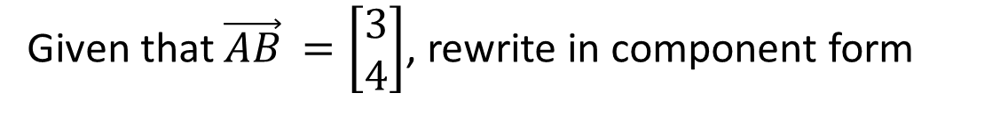


Example
Given that $\vec{AB}$ $=\left[\begin{matrix}3 \\ 4\end{matrix}\right]$, rewrite in component form
We can rewrite
$$\left[\begin{matrix}3 \\ 4\end{matrix}\right]=\left[\begin{matrix}3 \\ 0\end{matrix}\right]+\left[\begin{matrix}0 \\ 4\end{matrix}\right]$$
$$\vec{AB}=3i+4j$$

Slide 6
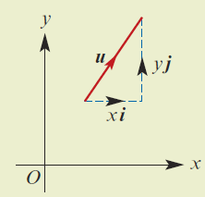


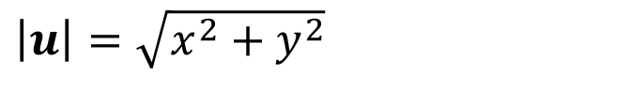
Magnitude of Vectors
We can write $u=\left[\begin{matrix}x \\ y\end{matrix}\right],$ as $u=xi+yj$
The magnitude of vector $u$, is denoted by $|u|$
$\left|u\right|=\sqrt{x^{2}+y^{2}}$
Sadler Ex 4A Q7

Slide 7





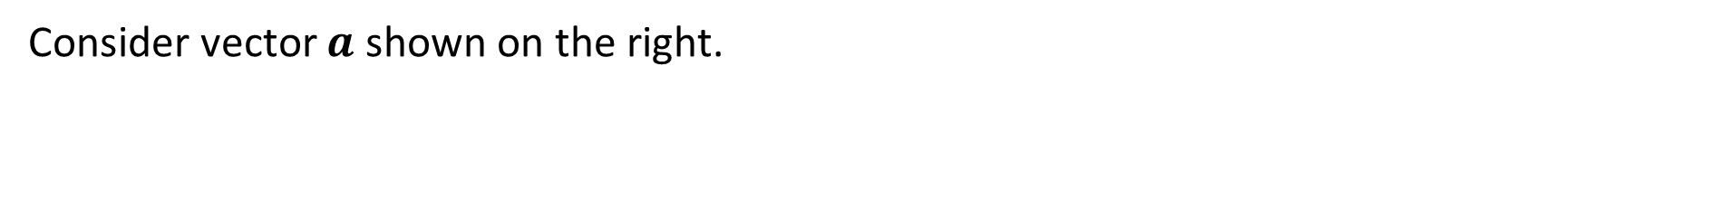



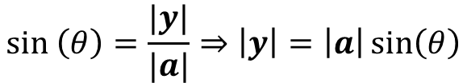

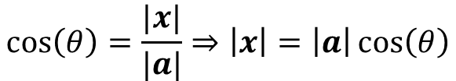
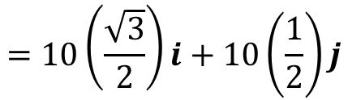
Component Vectors with trigonometry
Consider vector $a$ shown on the right.
$$a$$
We can express it in terms of rectangular components of $x$ and $y$
$$y$$
$$θ$$
We can rewrite $a=x+y$
$$x$$
$$cos\left(θ\right)=\frac{|x|}{|a|}⇒\left|x\right|=\left|a\right|\cos\left(θ\right)$$
$$sin \left(θ\right)=\frac{|y|}{|a|}⇒\left|y\right|=\left|a\right|\sin\left(θ\right)$$
$$∴a=\left|a\right|\cos\left(θ\right)i+\left|a\right|\sin\left(θ\right)j$$
Example: Express the following force in terms component vector form
$$10\cos\left(30\right)i+10\sin\left(30\right)j$$
$$=10\left(\frac{\sqrt{3}}{2}\right)i+10\left(\frac{1}{2}\right)j$$
10N
$$=5\sqrt{3}i+5j$$
$$30°$$

Slide 8
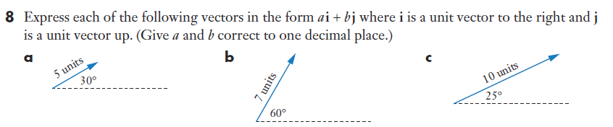




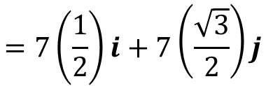
Sadler 4A Q8
$$7\cos\left(60\right)i+7\sin\left(60\right)j$$
$$10\cos\left(25\right)i+10\sin\left(25\right)j$$
$$=7\left(\frac{1}{2}\right)i+7\left(\frac{\sqrt{3}}{2}\right)j$$
$$=9.1i+4.2j$$
$$=3.5i+6.1j$$

Slide 9
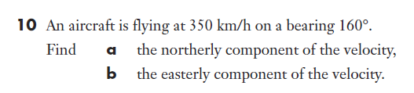


Sadler 4A Q10

Slide 10
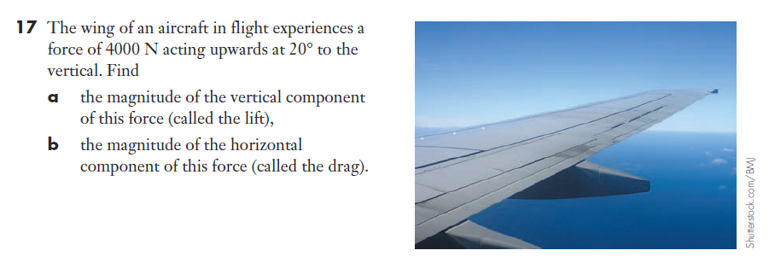




Sadler 4A Q17

Slide 11

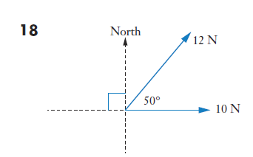







Sadler 4A Q18

Slide 12
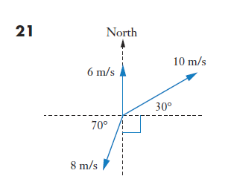













Sadler 4A Q21

Slide 13
Independent practice
Sadler Ex 4A

