Slide 1
Vectors
Unit Vectors and Further Examples

Slide 2
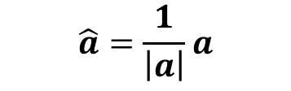
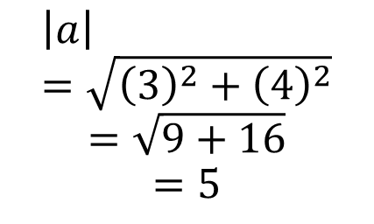

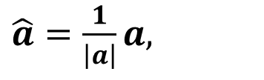

Unit Vectors
A unit vector is a vector with magnitude = 1
Both $i$ and $j$ are unit vectors
The unit vector in the direction of $a$ is denoted by $\hat{a}$
Since $\left|\hat{a}\right|=1,$
$\left|a\right|\hat{a}=a,$
$\hat{a}=\frac{1}{\left|a\right|}a,$
Cambridge Ch 17B Ex 9
Let $a=3i+4j$
Find $|a|$, the magnitude of $a$, hence find the unit vector in the direction of $a$
$$\left|a\right|=\sqrt{{\left(3\right)}^{2}+{\left(4\right)}^{2}}$$
$$=\sqrt{9+16}$$
$$=5$$
$$\hat{a}=\frac{1}{\left|a\right|}a$$
$$=\frac{1}{5}\left(3i+4j\right)$$

Slide 3
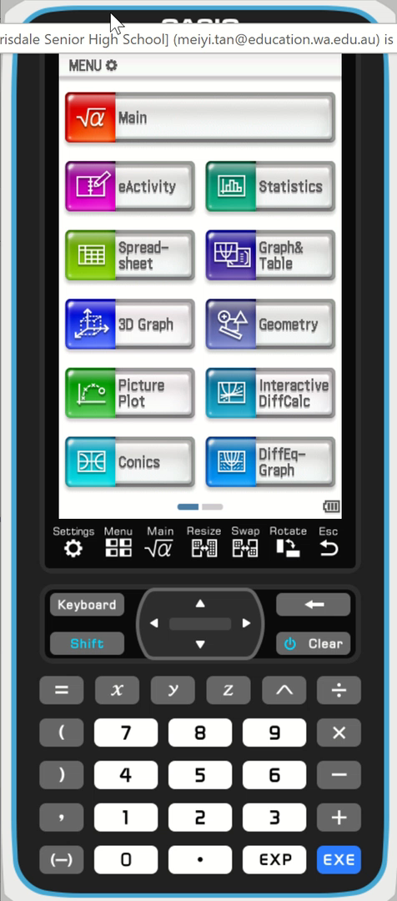


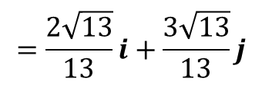

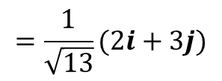

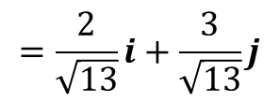
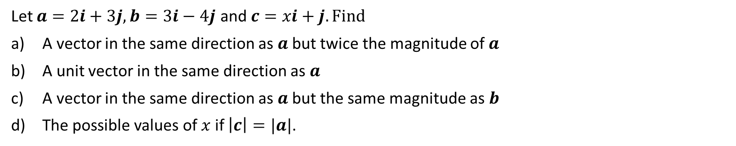

Sadler 4B Example 1
Let $a=2i+3j, b=3i−4j$ and $c=xi+j. Find$
A vector in the same direction as $a$ but twice the magnitude of $a$
A unit vector in the same direction as $a$
A vector in the same direction as $a$ but the same magnitude as $b$
The possible values of $x$ if $\left|c\right|=|a|$.
a) To be twice the magnitude, the scalar multiple must be 2
Required vector $=2a$
$$=2(2i+3j)$$
$$=4i+6j)$$
b) Magnitude $=\sqrt{2^{2}+3^{2}}=\sqrt{13}$
Unit vector, $\hat{a}=\frac{1}{\left|a\right|}a$
$$=\frac{1}{\sqrt{13}}(2i+3j)$$
$$=\frac{2}{\sqrt{13}}i+\frac{3}{\sqrt{13}}j$$
$$=\frac{2\sqrt{13}}{13}i+\frac{3\sqrt{13}}{13}j$$

Slide 4

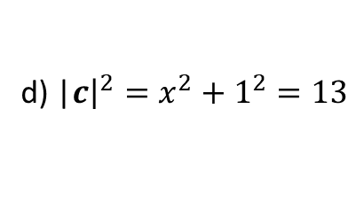

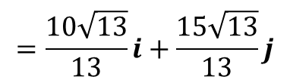
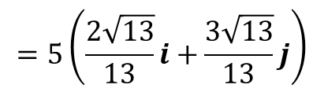


Sadler 4B Example 1
Let $a=2i+3j, b=3i−4j$ and $c=xi+j. Find$
A vector in the same direction as $a$ but twice the magnitude of $a$
A unit vector in the same direction as $a$
A vector in the same direction as $a$ but the same magnitude as $b$
The possible values of $x$ if $\left|c\right|=|a|$.
c) |$b|=\sqrt{3^{2}+{\left(−4\right)}^{2}}=5$
Mulitply unit vector in part (b) by magnitude of $b$
$$=5\left(\frac{2\sqrt{13}}{13}i+\frac{3\sqrt{13}}{13}j\right)$$
$$=\frac{10\sqrt{13}}{13}i+\frac{15\sqrt{13}}{13}j$$
d) |$c{\left.​\right|}^{2}=x^{2}+1^{2}=13$
$$x^{2}=12$$
$$x=±2\sqrt{3}$$

Slide 5




Sadler 4B Example 2
A body is moving with velocity $\left(7i+24j\right) m/s$. How far will it travel in twenty seconds?
Speed $=|7i+24j|$
$$=\sqrt{7^{2}+{24}^{2}}$$
$$=25 m/s$$
Distance travelled $=25\left(20\right)=500 m$

Slide 6



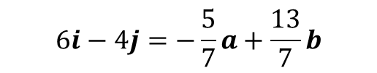



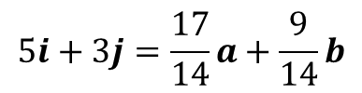

Sadler 4B Example 3
Using $a=2i+3j and b=4i−j$ as base vectors, express each of the following in the form $λa+μb$
a) $5i+3j$ b) $6i−4j$
Let $5i+3j=λa+μb$
Let $6i−4j=λa+μb$
$5i+3j=λ(2i+3j)+μ(4i−j)$
$$=λ(2i+3j)+μ(4i−j)$$
$5i+3j=2λi+3λj+4μi−μj$
$6i−4j=\left(2λ+4μ\right)i+(3λ−μ)j$
$5i+3j=\left(2λ+4μ\right)i+(3λ−μ)j$
Comparing $i$ components $6=2λ+4μ −(1)$
Comparing $i$ components $5=2λ+4μ −(1)$
Comparing $j$ components $−4=3λ−μ −\left(2\right)$
Comparing $j$ components $3=3λ−μ −\left(2\right)$
Solving (1) and (2) simultaneously, $λ=\frac{17}{14}, μ=\frac{9}{14}$
Solving (1) and (2) simultaneously, $λ=−\frac{5}{7}, μ=\frac{13}{7}$
$$5i+3j=\frac{17}{14}a+\frac{9}{14}b$$
$$6i−4j=−\frac{5}{7}a+\frac{13}{7}b$$

Slide 7
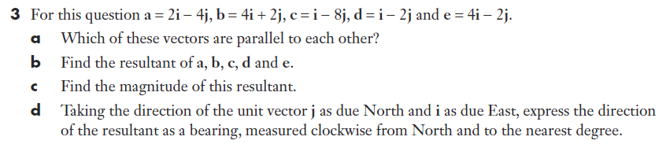






Sadler 4B Q 3

Slide 8
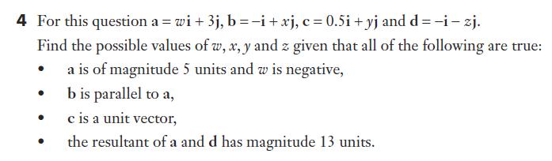




Sadler 4B Q 4

Slide 9


Sadler 4B Q 4

Slide 10
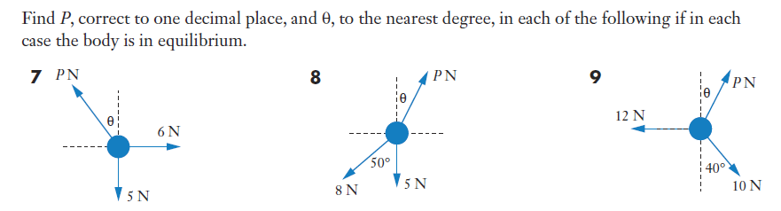


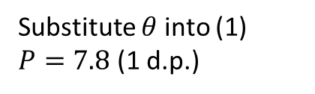

Sadler 4B Qn 7
If the body is in equilibrium, there are no ‘surplus’ force in any direction.
As such all the forces must balance.
Horizontal force must balance:
$$P\sin{θ}=6 −(1)$$
Vertical force must balance:
$$P\cos{θ}=5 −(2)$$
Divide (1) by (2)
$$\tan{θ}=\frac{6}{5} −(2)$$
Substitute $θ$into (1)
$P=7.8$ (1 d.p.)
$$θ=50° (nearest degree)$$

Slide 11




Sadler 4B Qn 8

Slide 12
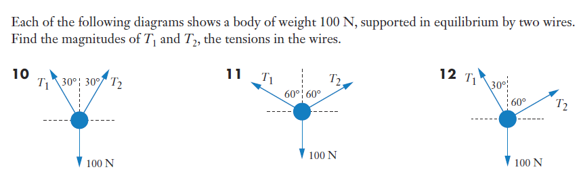





Sadler 4B Q10

Slide 13
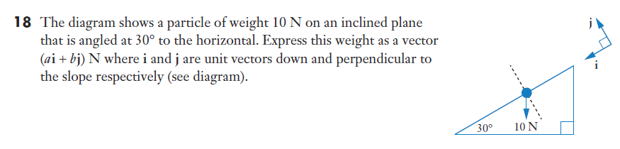
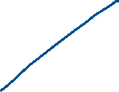
Sadler 4B Q18

Slide 14
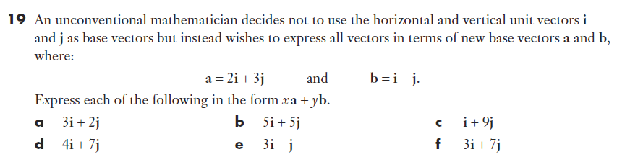








Sadler 4B Q 19a

Slide 15

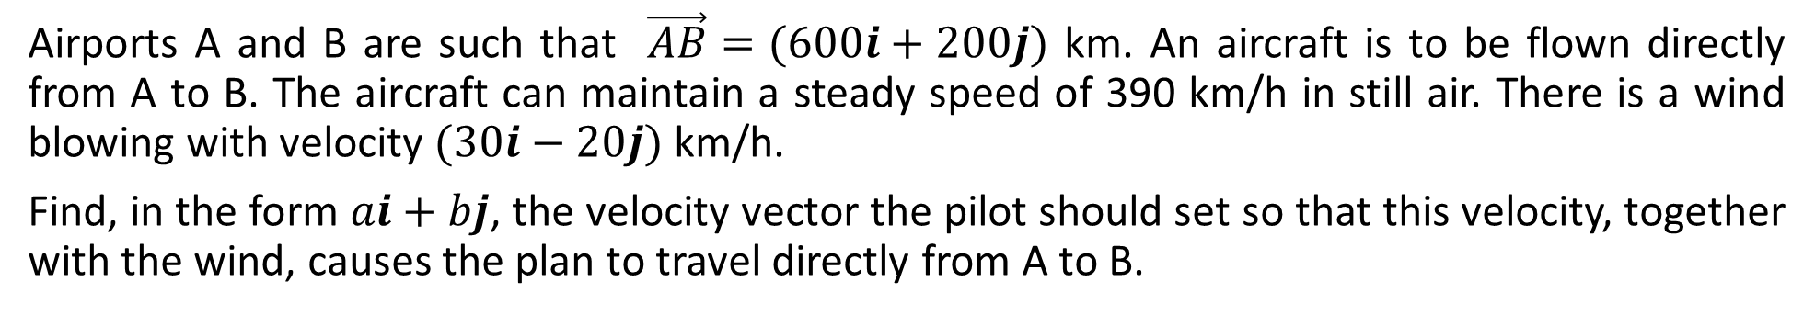


Sadler 4B Example 4
Airports A and B are such that $\vec{AB}=(600i+200j)$ km. An aircraft is to be flown directly from A to B. The aircraft can maintain a steady speed of 390 km/h in still air. There is a wind blowing with velocity $(30i−20j)$ km/h.
Find, in the form $ai+bj$, the velocity vector the pilot should set so that this velocity, together with the wind, causes the plan to travel directly from A to B.
$$ai+bj+30i−20j=λ\left(600i+200j\right), λ>0$$
Comparing $i$ components $a+30=600λ −(1)$
Comparing $j$ components $b−20=200λ −\left(2\right)$
B
$$30i−20j$$
Dividing (1) by (2) $\frac{a+30}{b−20}=3$
$$ai+bj$$
$$a+30=3b−60$$
$$a=3b−90 −(3)$$
$$ai+bj$$
Speed the aircraft can travel is $390=\sqrt{a^{2}+b^{2}}$
A
$$a^{2}+b^{2}={390}^{2} −(4)$$
Solving (3) and (4) simultaneously, $a=−378,b=−96,a=360,b=150$
$$∵λ>0, a≠−378,b≠−96,a=360,b=150$$
Required velocity $=(360i+150j)$km/h

Slide 16
Independent practice
Sadler 4B

