Slide 1
Vectors
Position Vectors and Further Examples

Slide 2
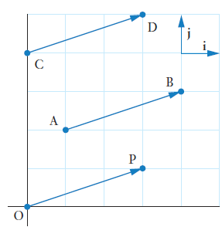
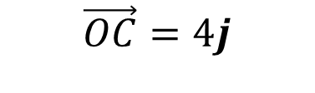
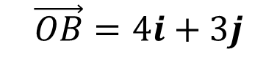
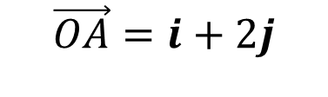
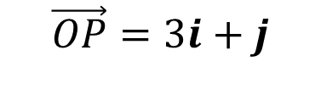
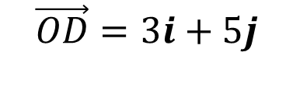
Position Vectors
Position vectors start from the origin $O$
Consider the points $O, A, B, C, D$ and $P$ shown in the diagram
Determine the position vectors $A, B, C, D$ and $P$
$$\vec{OA}=i+2j$$
$$\vec{OB}=4i+3j$$
$$\vec{OC}=4j$$
$$\vec{OD}=3i+5j$$
$$\vec{OP}=3i+j$$

Slide 3
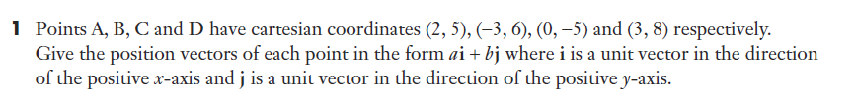
Sadler 4C Q1

Slide 4




Sadler 4C Example 1
Points A and B have position vectors $2i+3j,and 5i−j$. $Find$ $\vec{AB}$
$$\vec{AB} =\vec{AO}+\vec{OB}$$
$$=−\vec{OA}+\vec{OB}$$
$$=−(2i+3j)+5i−j$$
$$=3i−4j$$

Slide 5
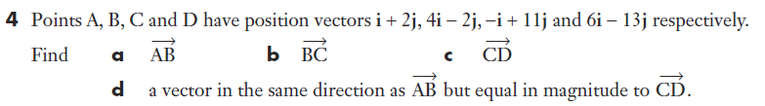


















Sadler 4C Q4

Slide 6








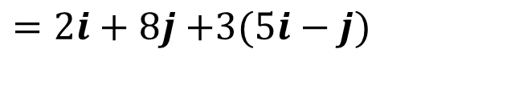
Sadler 4C Example 2
At 1 pm, a ship is at a location A, position vector $(2i+8j)$ km, and is moving with velocity $\left(5i−j\right)$ km/h. If the ship continues with this velocity, what will be its position vector at 4 pm?
Distance $\vec{AB}=3(5i−j)$ km
$$A$$
$$\vec{AB}=−\vec{OA}+\vec{OB}$$
$$B$$
$$\vec{OB}=\vec{AB}+\vec{OA}$$
$=2i+8j$ $+3(5i−j)$
$$O$$
$$=17i+5j$$
At 4pm the ship will be at position vector $17i+5j$

Slide 7








Sadler 4C Q7

Slide 8
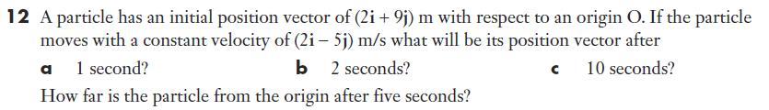







Sadler 4C Q12

Slide 9


Sadler 4C Q12

Slide 10



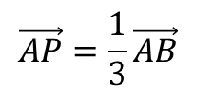


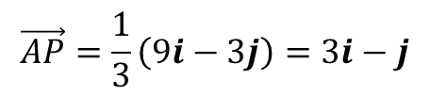





Sadler 4C Example 3
Points A and B have position vectors $i+7j$ and $10i+4j$ respectively. Find the position vector of the point that divides AB internally in the ratio 1: 2.
$$\vec{AP}=\frac{1}{3}\vec{AB}$$
$$A$$
$$\vec{AB}=−\vec{OA}+\vec{OB}$$
$$P$$
$$=−(i+7j)+10i+4j$$
$$B$$
$$=9i−3j$$
$$\vec{AP}=\frac{1}{3}\left(9i−3j\right)=3i−j$$
$$O$$
$$\vec{OP}=\vec{OA}+\vec{AP}$$
$$=i+7j+3i−j$$
$$=4i+6j$$

Slide 11
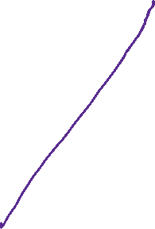



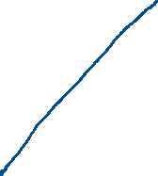
Sadler 4C Q16

Slide 12

Sadler 4C Q14
Collinear: $\vec{BA}$ and $\vec{BC}$ are parallel and scalar multiples of each other

Slide 13
Independent practice
Sadler 4C

