Slide 1
Vectors
Relative Displacement

Slide 2
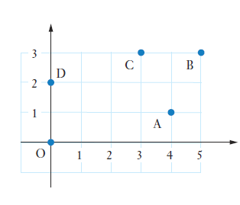
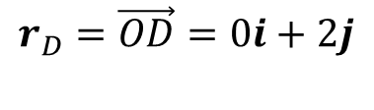
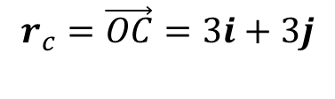
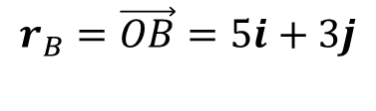
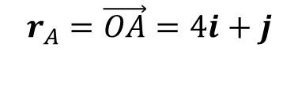
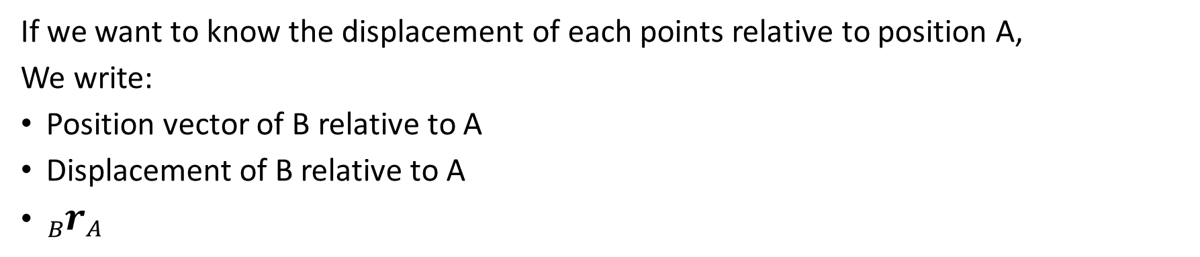
Relative Displacement
Consider the points $O, A, B, C \text{and} D$ shown in the diagram
The relative position vectors of $A, B, C, D$ are:
$$r_{A}=\vec{OA}=4i+j$$
$$r_{B}=\vec{OB}=5i+3j$$
$$r_{c}=\vec{OC}=3i+3j$$
$$r_{D}=\vec{OD}=0i+2j$$
If we want to know the displacement of each points relative to position A,
We write:
Position vector of B relative to A
Displacement of B relative to A
${{}_{B}^{ }r}_{A}$

Slide 3
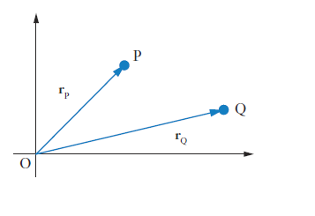
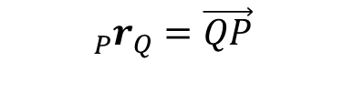
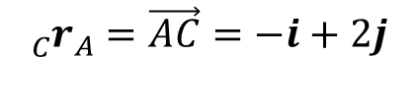
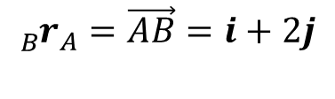
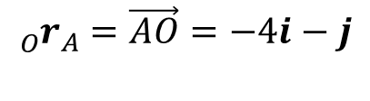
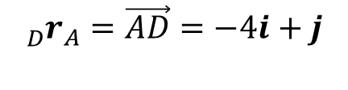
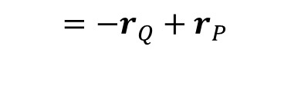
Relative Displacement
Determine the displacement of each points relative to A
$${{}_{B}^{ }r}_{A}=\vec{AB}=i+2j$$
$${{}_{C}^{ }r}_{A}=\vec{AC}=−i+2j$$
$${{}_{D}^{ }r}_{A}=\vec{AD}=−4i+j$$
$${{}_{O}^{ }r}_{A}=\vec{AO}=−4i−j$$
In general, P relative to Q is given by:
$${{}_{P}^{ }r}_{Q}=\vec{QP}$$
$$=−r_{Q}+r_{P}$$

Slide 4
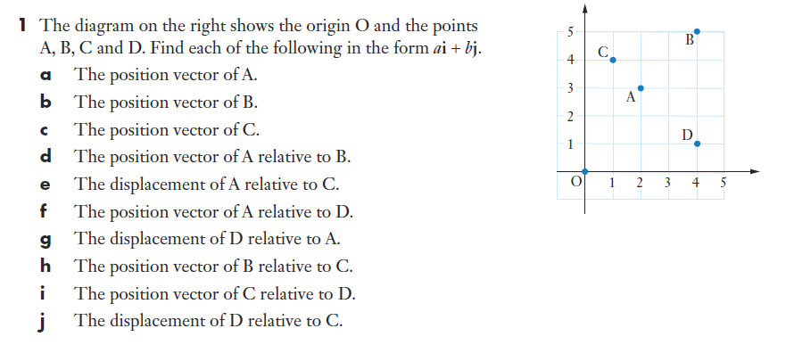







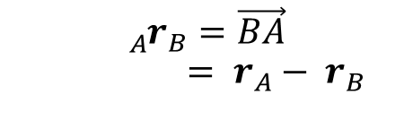







Sadler 6A Q1a-f
$${{}_{ }^{ }r}_{A}=2i+3j$$
$${{}_{A}^{ }r}_{C}={{}_{ }^{ }r}_{A}−{{}_{ }^{ }r}_{C}$$
$${{}_{ }^{ }r}_{B}=4i+5j$$
$$=2i+3j−(i+4j)$$
$${{}_{ }^{ }r}_{C}=i+4j$$
$$=i−j$$
$${{}_{A}^{ }r}_{B}=\vec{BA}$$
$$={{}_{ }^{ }r}_{A}−{{}_{ }^{ }r}_{B}$$
$${{}_{A}^{ }r}_{D}={{}_{ }^{ }r}_{A}−{{}_{ }^{ }r}_{D}$$
$${{}_{D}^{ }r}_{A}={{}_{ }^{ }r}_{D}−{{}_{ }^{ }r}_{A}$$
$$=2i+3j−(4i+j)$$
$$=4i+j−(2i+3j)$$
$$=2i+3j−(4i+5j)$$
$$=−2i+2j$$
$$=2i−2j$$
$$=−2i−2j$$

Slide 5






Sadler 6A Example 2
Ship A has position vector $\left(20i+10j\right)km.$ Relative to an observer on A, a second ship B has position vector $\left(3i−8j\right)km$. Find the position vector of the second ship.
$$r_{A} =\vec{OA}=\left(20i+10j\right)$$
$${{}_{B}^{ }r}_{A}=\vec{AB}=\left(3i−8j\right)$$
$$r_{B}−r_{A}=\left(3i−8j\right)$$
$$r_{B}−\left(20i+10j\right)=\left(3i−8j\right)$$
$$r_{B}=\left(20i+10j\right)+\left(3i−8j\right)$$
$$r_{B}=23i+2j$$

Slide 6






Sadler 6A Q6
$$r_{A} =\vec{OA}=\left(5i+2j\right)$$
$${{}_{A}^{ }r}_{B}=\vec{BA}=\left(8i+3j\right)$$
$$r_{A}−r_{B}=\left(8i+3j\right)$$
$$\left(5i+2j\right)−r_{B}=\left(8i+3j\right)$$
$$r_{B}=\left(5i+2j\right)−\left(8i+3j\right)$$
$$r_{B}=\left(−3i−1j\right) km$$
$$\left|r_{B}\right|=\sqrt{{\left(−3\right)}^{2}+{\left(−1\right)}^{2}}=\sqrt{10} km=3.16km$$

Slide 7

















Sadler 6A Q8
3. Prove
1. Define your position vectors
$$LHS= {{{}_{D}^{ }r}_{E}+{}_{E}^{ }r}_{F}$$
$$r_{D}=ai+bj$$
$$=\left(a−c\right)i+\left(b−d\right)j+(c−e)i+(d−f)j$$
$$r_{E}=ci+dj$$
$$=\left(a−c+c−e\right)i+\left(b−d+d−3\right)j$$
$$r_{F}=ei+fj$$
$$=(a−e)i+(b−f)j$$
2. Define your relative vectors to position vectors
$$={{}_{D}^{ }r}_{F}$$
$${{}_{D}^{ }r}_{E}=r_{D}−r_{E}$$
$${{}_{D}^{ }r}_{F}=r_{D}−r_{F}$$
$$=ai+bj−(ci+dj)$$
$$=ai+bj−(ei+fj)$$
$$=(a−c)i+(b−d)j$$
$$=(a−e)i+(b−f)j$$
$${{}_{E}^{ }r}_{F}=r_{E}−r_{F}$$
$$=ci+dj−(ei+fj)$$
$$=(c−e)i+(d−f)j$$

Slide 8
Independent practice
Sadler 6A

