Slide 1
Vectors
Relative Velocity

Slide 2
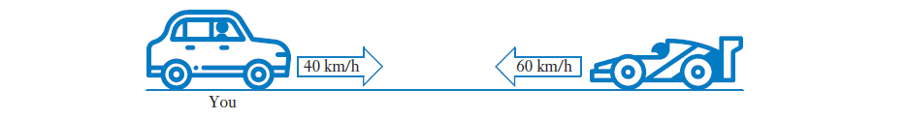




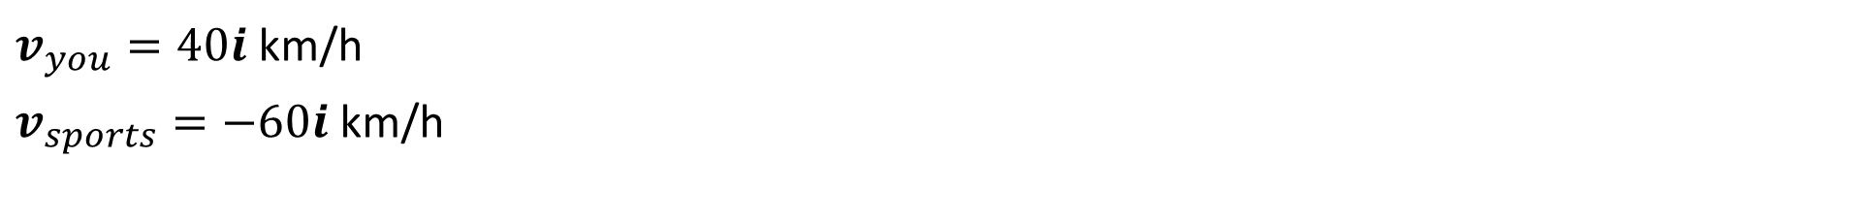
Relative Velocity
Given that displacement of A relative to B is represented:
$${{}_{A}^{ }r}_{B}=r_{A}−r_{B}$$
This can be extended to velocity vectors where,
Velocity of A relative to B is given by
$${{}_{A}^{ }v}_{B}=v_{A}−v_{B}$$
Determine the velocity of the sports car relative to you
$v_{you}=40i$km/h
$v_{sports}=−60i$km/h
$${{}_{sports}^{ }v}_{you}=v_{sports}−v_{you}$$
$${{}_{sports}^{ }v}_{you}=−60i−40i=−100i$$

Slide 3



Sadler 6B Example 4
If$v_{A}=7i−2j$ and $v_{B}=6i+j$, find ${{}_{A}^{ }v}_{B}$.
$${{}_{A}^{ }v}_{B}=v_{A}−v_{B}$$
$$=7i−2j−(6i+j)$$
$$=i−3j$$

Slide 4
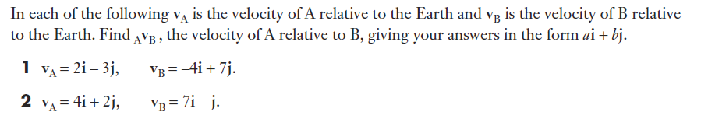






Sadler 6B Q1 – 2
$${{}_{A}^{ }v}_{B}=v_{A}−v_{B}$$
$$=2i−3j−(−4i+7j)$$
$$=6i−10j$$
$${{}_{A}^{ }v}_{B}=v_{A}−v_{B}$$
$$=4i+2j−(7i−j)$$
$$=−3i+3j$$

Slide 5
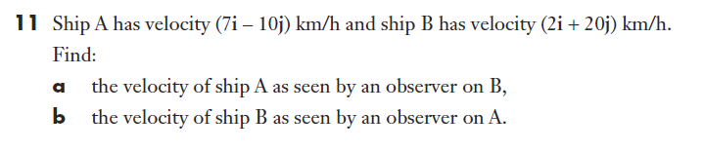





Sadler 6B Q11

Slide 6





Sadler 6B Q14
$${{}_{A}^{ }v}_{B}=v_{A}−v_{B}$$
$$v_{B}=v_{A}−{{}_{A}^{ }v}_{B}$$
$$v_{B}=3i−7j−(2i+5j)$$
$$v_{B}=i−12j$$

Slide 7






Sadler 6B Example 5
To a person on a ship travelling with velocity $(15i+2j)$ km/h, the wind appears to have velocity $(−9i+2j)$ km/h. Find the true velocity of the wind.
$${{}_{ }^{ }v}_{Ship}=15i+2j$$
$${{}_{Wind}^{ }v}_{Ship}=−9i+2j$$
$${{}_{Wind}^{ }v}_{Ship}={{}_{ }^{ }v}_{Wind}−{{}_{ }^{ }v}_{Ship}$$
$${{}_{ }^{ }v}_{Wind}={{}_{Wind}^{ }v}_{Ship}+{{}_{ }^{ }v}_{Ship}$$
$${{}_{ }^{ }v}_{Wind}=−9i+2j+15i+2j$$
${{}_{ }^{ }v}_{Wind}=(6i+4j)$ km/h

Slide 8




Sadler 6B Q20
$${{}_{ }^{ }v}_{Ship}=7i+2j$$
$${{}_{Wind}^{ }v}_{Ship}=6i−j$$
$${{}_{Wind}^{ }v}_{Ship}={{}_{ }^{ }v}_{Wind}−{{}_{ }^{ }v}_{Ship}$$
$${{}_{ }^{ }v}_{Wind}=6i−j+7i+2j$$
${{}_{ }^{ }v}_{Wind}=(13i+j)$ km/h

Slide 9
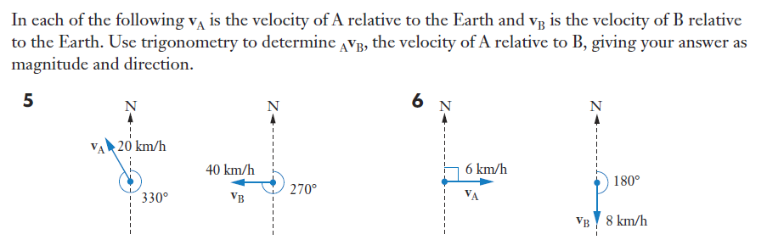
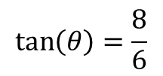

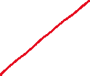




Sadler 6B Q6 (Using Trigonometry)
$${{}_{A}^{ }v}_{B}=v_{A}−v_{B}$$
$${\left|{{}_{A}^{ }v}_{B}\right|}^{2}=\sqrt{8^{2}+6^{2}}$$
$$|{{}_{A}^{ }v}_{B}|=10$$
$$\tan\left(θ\right)=\frac{8}{6}$$
$$θ=53.1301 °(4d.p)$$
Bearing $=90−53=037°$
Magnitude of ${{}_{A}^{ }v}_{B}$ $=10$km/h and bearing is $037°$

Slide 10





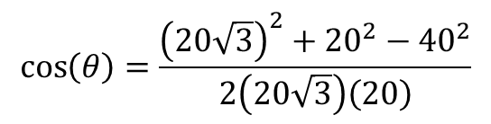

Sadler 6B Q5 (Using Trigonometry)
$${\left|{{}_{A}^{ }v}_{B}\right|}^{2}={20}^{2}+{40}^{2}−2\left(20\right)\left(40\right)\cos{(60)}$$
$$|{{}_{A}^{ }v}_{B}|=20\sqrt{3}$$
$$\cos\left(θ\right)=\frac{{\left(20\sqrt{3}\right)}^{2}+{20}^{2}−{40}^{2}}{2\left(20\sqrt{3}\right)\left(20\right)}$$
$${{}_{A}^{ }v}_{B}=v_{A}−v_{B}$$
$$θ=90°$$
Bearing $=90−30=060°$
Magnitude of ${{}_{A}^{ }v}_{B}$ $=20\sqrt{3}$ km/h and bearing is $060°$

Slide 11





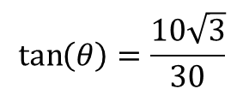






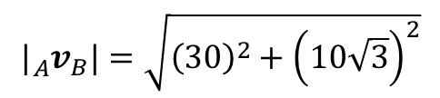
Sadler 6B Q5 (Using Velocity Vectors)
$$|{{}_{A}^{ }v}_{B}|=\sqrt{{\left(30\right)}^{2}+{\left(10\sqrt{3}\right)}^{2}}$$
$$|{{}_{A}^{ }v}_{B}|=\sqrt{1200}$$
$$v_{A}=−20\sin\left(30\right)i+20\cos{(30)}j$$
$$|{{}_{A}^{ }v}_{B}|=20\sqrt{3}$$
$$=−10i+10\sqrt{3}j$$
$$\tan\left(θ\right)=\frac{10\sqrt{3}}{30}$$
$$v_{B}=−40i$$
$${{}_{A}^{ }v}_{B}=v_{A}−v_{B}$$
$$θ=60°$$
$$=−10i+10\sqrt{3}j+40i$$
$$=30i+10\sqrt{3}j$$
Magnitude of velocity $=20\sqrt{3}$ km/h and bearing is $060°$

Slide 12



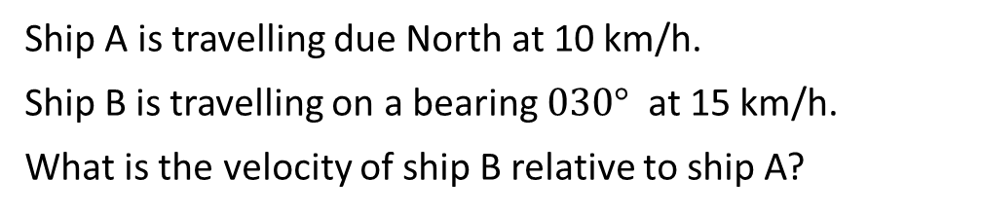
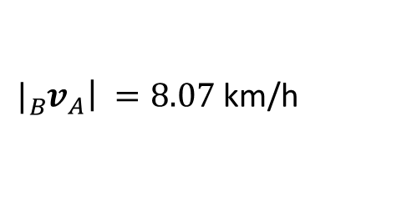

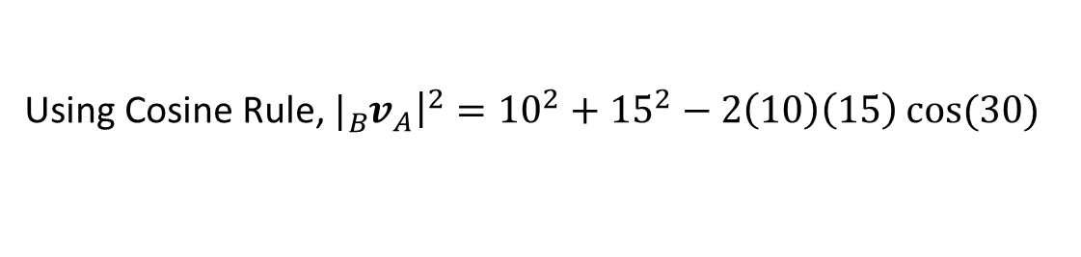


Sadler 6B Example 3
Ship A is travelling due North at 10 km/h.
Ship B is travelling on a bearing $030°$ at 15 km/h.
What is the velocity of ship B relative to ship A?
$v_{A}=10$ km/h
$v_{B}=15$ km/h
$${{}_{B}^{ }v}_{A}=v_{B}−v_{A}$$
Using Cosine Rule, ${|{}_{B}^{ }v}_{A}{\left.​\right|}^{2}={10}^{2}+{15}^{2}−2\left(10\right)\left(15\right)\cos{(30)}$
${|{}_{B}^{ }v}_{A}{\left.​\right|}^{ }=8.07$ km/h
$\cos{(θ})=\frac{{\left(8.07\right)}^{2}+{\left(15\right)}^{2}−{\left(10\right)}^{2}}{2\left(8.07\right)\left(15\right)}$
$$θ=38.21°$$
Bearing is $θ=30° +38.21°=068°$
Velocity of Ship B relative to Ship A is at a speed of 8.07 km/h on a bearing of $068°$

Slide 13
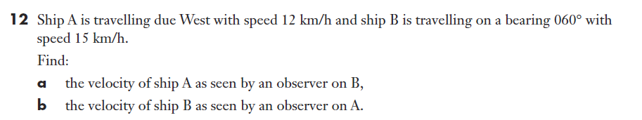



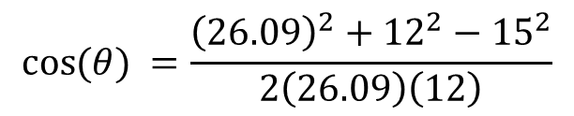


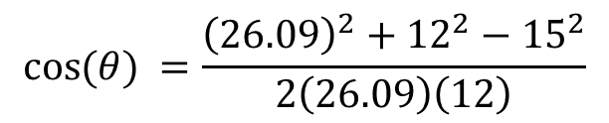




Sadler 6B Q12a
$v_{B}=15$ km/h
$${\cos{(θ)}}^{ }=\frac{{\left(26.09\right)}^{2}+{12}^{2}−{15}^{2}}{2\left(26.09\right)\left(12\right)}$$
$v_{A}=12$ km/h
$12$ km/h
$${{}_{A}^{ }v}_{B}=v_{A}−v_{B}$$
$15$ km/h
$$θ=16.72°$$
$${\left|{{}_{A}^{ }v}_{B}\right|}^{2}={15}^{2}+{12}^{2}−2\left(15\right)\left(12\right)\cos{(150)}$$
Bearing is $θ=270° −16.72°=253°$
${\left|{{}_{A}^{ }v}_{B}\right|}^{ }=26.09$ km/h
$${\cos{(θ)}}^{ }=\frac{{\left(26.09\right)}^{2}+{12}^{2}−{15}^{2}}{2\left(26.09\right)\left(12\right)}$$
Velocity of Ship A relative to Ship B is at a speed of 26.09 km/h on a bearing of $253°$

Slide 14



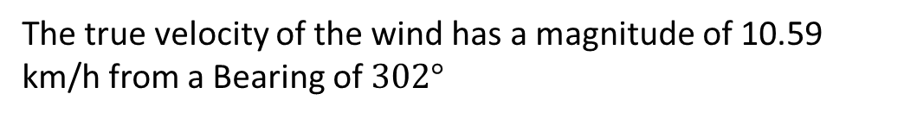







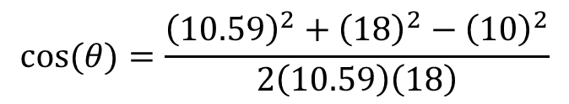
Sadler 6B Example 5
To a person on a ship moving at 18 km/h on a bearing $150°$, the wind appears to come from the south with speed $10$ km/h. Find the true velocity of the wind.
$$150°$$
${{}_{Wind}^{ }v}_{Ship}=10$ km/h
$v_{ship}=18$ km/h
$${{}_{Wind}^{ }v}_{Ship}={{}_{ }^{ }v}_{Wind}−{{}_{ }^{ }v}_{Ship}$$
$${{}_{ }^{ }v}_{Wind}={{}_{Wind}^{ }v}_{Ship}+{{}_{ }^{ }v}_{Ship}$$
$${\left|{{}_{ }^{ }v}_{Wind}\right|}^{2}={10}^{2}+{18}^{2}−2\left(10\right)\left(18\right)\cos{(30)}$$
$$\left|{{}_{ }^{ }v}_{Wind}\right|={10}^{2}+{18}^{2}−2\left(10\right)\left(18\right)\cos{(30)}$$
$$30°$$
$10$ km/h
$\left|{{}_{ }^{ }v}_{Wind}\right|=10.59$ km/h
$18$ km/h
$$\cos{(θ)}=\frac{{\left(10.59\right)}^{2}+{\left(18\right)}^{2}−{\left(10\right)}^{2}}{2\left(10.59\right)\left(18\right)}$$
From a Bearing of $=360° −30°−28.15°=302°$
$$θ=28.15°$$
The true velocity of the wind has a magnitude of 10.59 km/h from a Bearing of $302°$

Slide 15






Sadler 6B Q23

Slide 16

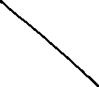





Sadler 6B Q22

Slide 17
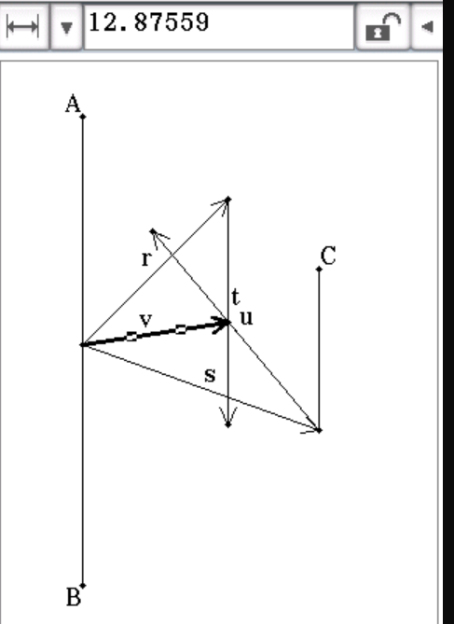
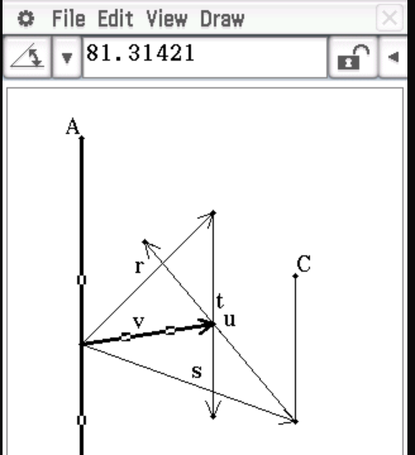
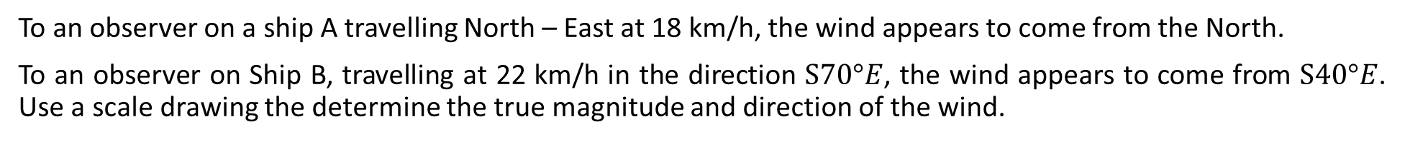
Sadler 6B Example 7
To an observer on a ship A travelling North – East at 18 km/h, the wind appears to come from the North.
To an observer on Ship B, travelling at 22 km/h in the direction $S70°E$, the wind appears to come from $S40°E$. Use a scale drawing the determine the true magnitude and direction of the wind.

Slide 18
Independent practice
Sadler 6B

